Slide 1


Artificial Intelligence and Productivity in Flanders
Petra Andries and Thomas Standaert — ECOOM–Inno (Ghent University)
Yannick Bormans, Yelzhas Kadyr, and Jo Reynaerts — ECOOM–STORE (KU Leuven)
Notes:
ECOOM-ONDERNEMERSCHAP
ECOOM-STORE

Slide 2
AI Barometer
Since 2021, ECOOM-Inno-Gent has tracked AI adoption and use of Flemish firms
Survey research design
Stratified random sampling
  Wide range of manufacturing and service sectors
  Micro, small, medium-sized, and large firms
Questionnaire
  Inspired by EU Survey on ICT usage and e-commerce in enterprises (Eurostat)
  Dynamic rather than static measuring instrument
Conducted annually until 2023, and biannually thereafter
More than 2.000 usable responses per wave (i.e., > 30% response rate)

Slide 3
Artificial intelligence and applications
Definition: “technologies that allow software, machines, and devices to analyze their environment and then solve problems or take actions to achieve a specific goal”
  AI technologies include (i) text mining; (ii) speech recognition; (iii) natural language generation; (iv) image recognition; (v) machine learning; (vi) robotic process automation; and (vii) autonomous robot, vehicles and drones
Firms can use AI in one or more functional areas, including sales and marketing; customer service; production; administration; strategic management; purchasing; logistics; ICT security; human resource management; and product development

Slide 4
Artificial intelligence and firm-level productivity
AI affects various aspects of business
  AI improves employee-level productivity at a variety of tasks (e.g., Brynjolfsson et al., 2025; Noy & Zhang, 2023; Peng et al., 2023)
  AI facilitates strategic decision-making (Csaszar et al., 2024; Doshi et al., 2025)
  AI contributes to product (Babina et al., 2024; Rammer et al., 2022; Wang & Wu, 2025) and process innovation (Rammer et al. 2022, Standaert & Andries, 2026)
Extant research has mainly found a positive impact of AI investments on firm-level productivity (Alderucci et al., 2020; Brown et al., 2025; Czarnitzki et al., 2023; Yang, 2022)

Slide 5
Research gap
Not all measures of AI investments are equally relevant
  AI patents measure AI-related inventions. Only a minority of firms develop AI products or services.
It is unclear whether the impact of AI on productivity differs by firm size
  Examining ICT investments in Belgian firms during 2002-2013, Dhyne et al. (2020) found that large firms benefit more from ICT than small firms

Slide 6
Research questions
Are AI adopters more productive than non-adopters?
Do productivity differences vary by firm size?
Does broader use of AI matter?

Slide 7
Data Sources
AI Barometer: large-scale survey monitoring AI use in Flemish firms (2021–2023).
Bel-first: firm-level financial and productivity data (value added, employment, capital).
Merged dataset: 6135 firm-year observations (2129 AI adopters).

Slide 8
AI Adoption Patterns Across Firms
By Year
  2021: 25%
  2022: 34%
  2023: 44%
By Firm Size
  Micro (1–9 employees): 16%
  Small (10–49): 24%
  Medium (50–249): 38%
  Large (250+): 21%
By Sector
  High adoption (15–20%)
  Manufacturing, Wholesale & Retail Trade, Professional, Scientific & Technical Services
  Medium adoption (7–11%)
  Information & Communication, Administrative & Support Services, Construction, Transportation & Storage, Health & Social Work
  Low adoption (≤ 2%)
  Accommodation & Food, Financial & Insurance, Utilities & Waste

Slide 9
Empirical Framework
We examine how AI adoption and AI breadth are linked to firm performance outcomes
  Value added, labor productivity, and total factor productivity.
We control for firm size, sector, year, capital, and employment to isolate AI-related differences
We compare AI adopters and non-adopters and assess how patterns vary by firm size.
Among adopters, we explore whether broader use of AI across more areas is associated with higher productivity.

Slide 10
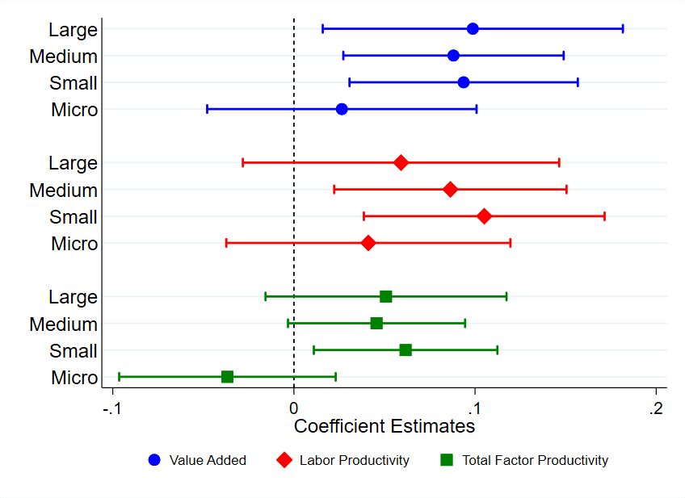

Estimated Productivity Differences Between AI Adopters and Non-Adopters, by Firm Size

Slide 11
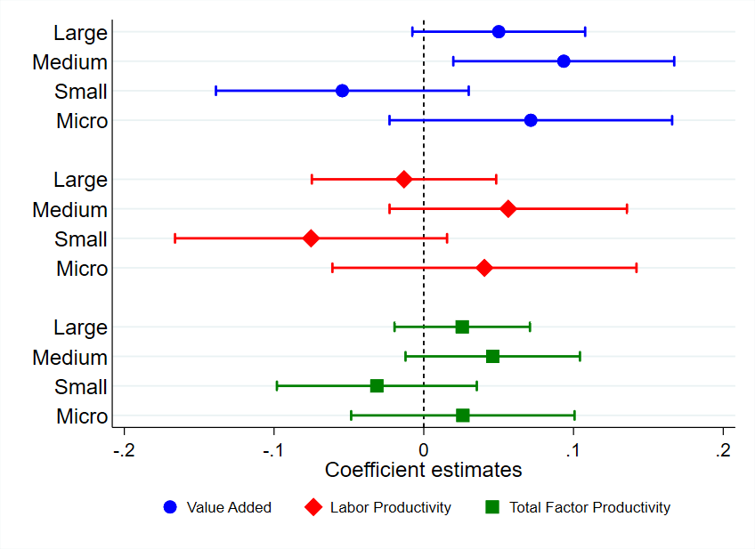

Estimated Association Between AI Breadth and Productivity, by Firm Size

Slide 12
Discussion: AI adoption
Small and medium-sized enterprises (SMEs) benefit more from AI adoption than micro or large firms
This finding contrasts with research examining the impact of ‘traditional’ ICT on productivity (Dhyne et al., 2020)
Possible explanations
  Brynjolfsson and Hitt (2003) showed that ICT’s productivity gains increased when paired with investments in organizational capital. Since SMEs are typically more constrained in making such investments than large firms, our results suggest that AI’s impact on productivity may be less dependent on complementary organizational capital than that of traditional ICT.
  Due to the greater organizational complexity of large firms, effectively deploying AI to advance firm objectives may be more challenging.

Slide 13
Discussion: breadth of AI adoption
The evidence for a positive relationship between the breadth of AI adoption and productivity is weaker and less robust
This finding suggests that firms either get stuck in experimenting with AI or fail to scale initial AI successes
  Each AI technology and application needs to individually pass the proof-of-concept phase before demonstrating proof of value (Haefner et al., 2023)
  Recent research by MIT found that 95% of GenAI pilots failed. However, the remaining 5% achieved rapid revenue growth.

Slide 14
Implications and avenues for future research
Theoretical contribution
  AI investments affect productivity in ways that differ from traditional ICT investments
Managerial implication
  SMEs that have not yet adopted AI should consider doing so
Policy implication
  Besides boosting AI adoption rates, government programs should aim at increasing successful experimentation with and scaling of AI
Avenues for future research
  How can micro firms use AI to increase productivity?
  Which factors impede the effectiveness of AI in large firms?
  Which complementary assets strengthen the impact of AI on productivity?

Slide 15
References
Alderucci, D., Branstetter, L., Hovy, E., Runge, A., & Zolas, N. (2020). Quantifying the impact of AI on productivity and labor demand: Evidence from US census microdata. In Allied social science associations—ASSA 2020 annual meeting.
Babina, T., Fedyk, A., He, A., & Hodson, J. (2024). Artificial intelligence, firm growth, and product innovation. Journal of Financial Economics, 151, 103745.
Brynjolfsson, E., & Hitt, L. M. (2003). Computing productivity: Firm-level evidence. Review of Economics and Statistics, 85(4), 793-808.
Brynjolfsson, E., Li, D., & Raymond, L. (2025). Generative AI at work. The Quarterly Journal of Economics, 140(2), 889-942.
Brown, R., Sun, H., Cowling, M., & David, D. Can We See it in the Numbers Yet? Artificial Intelligence, Firm-Level Productivity and SMEs. SSRN working paper.
Csaszar, F. A., Ketkar, H., & Kim, H. (2024). Artificial intelligence and strategic decision-making: Evidence from entrepreneurs and investors. Strategy Science, 9(4), 322-345.
Czarnitzki, D., Fernández, G. P., & Rammer, C. (2023). Artificial intelligence and firm-level productivity. Journal of Economic Behavior & Organization, 211, 188-205.
Dhyne, E., Konings, J., Van den Bosch, J., & Vanormelingen, S. (2020). The return on information technology: who benefits most?. Information systems research, 32(1), 194-211.
Doshi, A. R., Bell, J. J., Mirzayev, E., & Vanneste, B. S. (2025). Generative artificial intelligence and evaluating strategic decisions. Strategic Management Journal, 46(3), 583-610.
Haefner, N., Parida, V., Gassmann, O., & Wincent, J. (2023). Implementing and scaling artificial intelligence: A review, framework, and research agenda. Technological Forecasting and Social Change, 197, 122878.
Noy, S., & Zhang, W. (2023). Experimental evidence on the productivity effects of generative artificial intelligence. Science, 381(6654), 187-192.
Peng, S., Kalliamvakou, E., Cihon, P., & Demirer, M. (2023). The impact of AI on developer productivity: Evidence from Github Copilot. arXiv preprint arXiv:2302.06590.
Rammer, C., Fernández, G. P., & Czarnitzki, D. (2022). Artificial intelligence and industrial innovation: Evidence from German firm-level data. Research Policy, 51(7), 104555.
Standaert, T., & Andries, P. (2026). Overcoming difficulties in knowledge transfer: Harnessing the power of AI to drive process innovation. Technovation, 149, 103350.
Wang, X., & Wu, L. (2025). Artificial intelligence, lean startup method, and product innovations. Management Science. In press.
Yang, C. H. (2022). How artificial intelligence technology affects productivity and employment: Firm-level evidence from Taiwan. Research Policy, 51(6), 104536.

Slide 16
Appendix: AI Users by Year

Slide 17
Appendix: AI Users by Size

