Slide 1

Decomposing the R&D productivity puzzle: are ideas harder to find or does Europe suffer from a commercialization gap?
Dirk Czarnitzki, KU Leuven
Brussels, October 21st 2025

Slide 2
The European dilemma: R&D commercialization gap
Recent report on the future of European competitiveness
(the „Draghi report“):
Europe is facing many challenges, among others in the area of R&D and innovation
Europe largely missed out on the digital revolution led by the internet and the productivity gains it brought:
  the productivity gap between the EU and the US is largely explained by the tech sector.
  The EU is weak in the emerging technologies that will drive future growth. Only four of the world’s top 50 tech companies are European.

Slide 3
The European dilemma: R&D commercialization gap
Europe is stuck in a static industrial structure:
  there is no EU company with a market capitalisation over EUR 100 billion that has been set up from scratch in the last fifty years,
  while all six US companies with a valuation above EUR 1 trillion have been created in this period.
EU companies are specialised in mature technologies
  potential for breakthroughs is limited,
  European firms spend less on research and innovation (R&I) – EUR 270 billion less than their US counterparts in 2021.
  The top 3 investors in R&I in Europe have been dominated by automotive companies for the past 20 years. Same in the US in early 2000s, with autos and pharma leading, but now the top 3 are all in tech.
Conclusion of Draghi report:
Europe fails to translate innovation into commercialisation

Slide 4
(Global) Declining research productivity
Debate in scholarly literature
  research efforts are rising substantially while research productivity is declining sharply;
  ideas that imply (exponential) growth are possibly harder to find than in the past
  Bloom et al., 2020, Boeing and Hünermund, 2020, Goldin et al., 2024.
Example: Moore’s Law
  number of researchers required today to achieve the famous doubling of computer chip density is more than 18 times larger than the number required in the early 1970s.

Slide 5
Empirical study
Shed some light on the questions
  whether ideas are harder to find,
  and whether Europe lacks a R&D-commercialization gap
  relative to other regions in the world?
We estimate for different regions in the world
  R&D-patent elasticities between 2004 and 2019.
  R&D-labor productivity elasticities between 2004 and 2022.

Slide 6
Data
EU Industrial R&D Investment Scoreboard
Firm-level panel of the Top 2500 R&D performers between 2004 and 2022.
Supplemented with patent data collected from the PATSTAT database.
Time periods:
  years before the global financial crisis (2004-2007),
  the global financial crisis (2008-2010),
  years after the financial crisis (2011-2015),
  years before the COVID pandemic (2016-2019), and
  the COVID pandemic (2020-2022)

Slide 7
Econometric estimations
Are ideas harder to find?
  count of inventions for which patents have been filed at least at two IP5 offices
R&D-commercialization gap:
  labor productivity (= sales per employee)

Slide 8
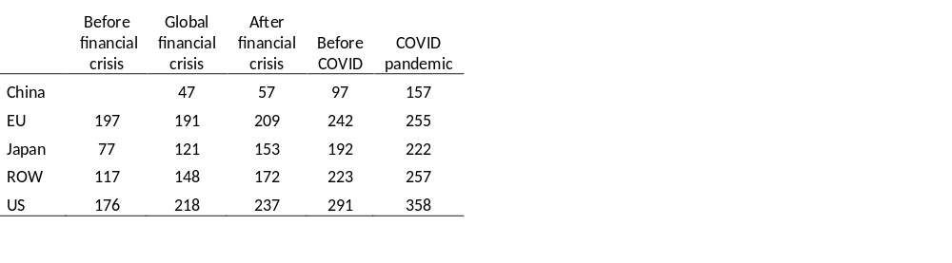
Average R&D investment across regions and time
(million EUR, real values)

Slide 9
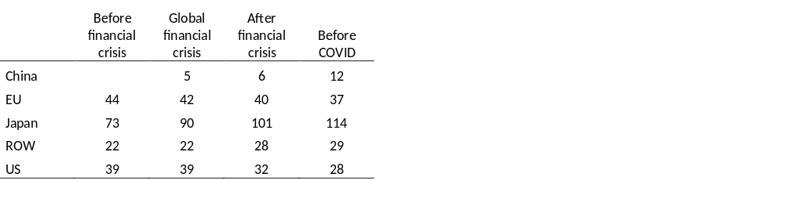
Average patenting across regions and time
(families at 2 IP5)

Slide 10
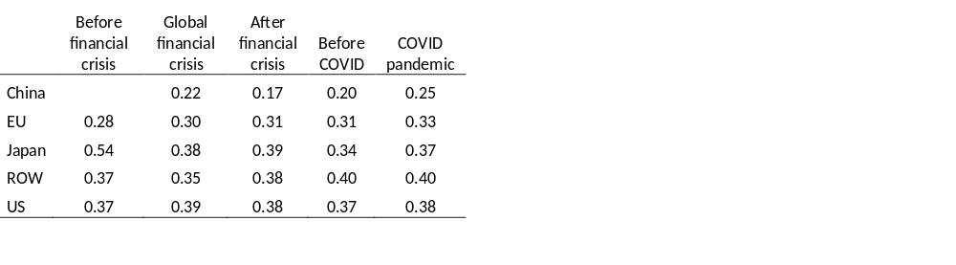
Average sales per employee across regions and time
(million EUR, real values)

Slide 11
Econometric results: time patterns across world regions

Slide 12
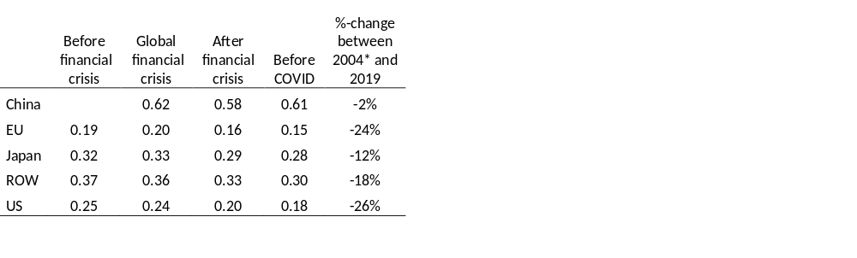
Estimated R&D-patent elasticities across regions and time
All coefficient estimates of the R&D variables are statistically significant at the 5% level.
F-tests on coefficient differences within each region across time show that the downward trends are also statistically significant at the 5% level except for China.
Further F-tests reveal that the differences between regions are statistically significant in each time period.
* For China, the relative change in elasticities is calculated from 2008 to 2019.

Slide 13
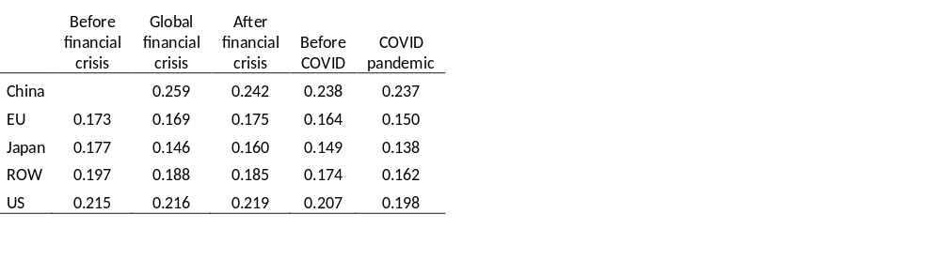
Estimated R&D-labour-productivity elasticities across regions and time
All coefficient estimates of the R&D variables are statistically significant at the 5% level.
F-tests on coefficient differences within each region across time show that the downward trends are also statistically significant at the 5% level except for China.
Further F-tests reveal that the differences between regions are statistically significant in each time period except the first one.

Slide 14
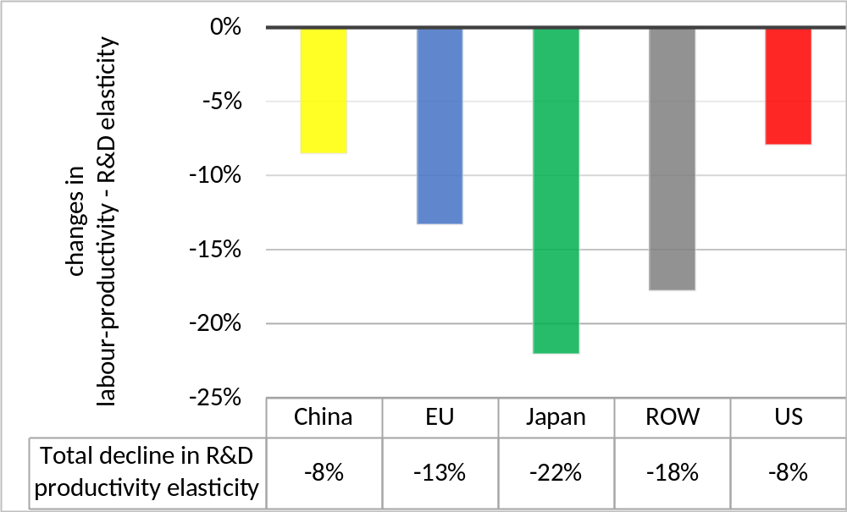
Estimated total decline in R&D-labour productivity elasticity (2004*-2022) across regions (*China from 2008)

Slide 15
Conclusions
The data analysis of the world’s top 2500 R&D performers does not suggest an easy future for Europe.
Since the aftermath of the financial crisis, the “R&D-to-idea” relationships have been falling most in the United States and Europe.
The R&D-labor productivity elasticities have recently been lowest in Japan and the EU, and have been falling since 2004 in all global regions.

Slide 16
Policy actions
Not obvious what policy actions are the most promising instruments to achieve higher growth.
Draghi report suggests
  that closing the innovation gap with the United States and China should be one of the future policy priorities.
  EU should make an effort to position universities and research institutions at the frontier of academic excellence, and make it easier for researcher to commercialize their ideas.
  Scaling up after commercialization should be facilitated better.
  Such goals could, among other factors, be achieved by supporting a more developed and integrated financial and venture capital markets.

Slide 17
Policy actions
Von der Leyen’s policy guidelines and the Draghi report point out:
“making business easier and deepen our Single Market”
by reducing bureaucratic hurdles that restrict goods, services, money, and people to move freely across EU Member States will strengthen EU’s innovation competitiveness.

Slide 18
Some promising policies
The convention on a “European patent” took more than 30 years to become effective.
  The European Unitary Patent has only become effective since Sept. 1st 2024.
  Only since then companies can obtain patent protection in 18 Member States (not even in all 27 yet).
EU implemented policy reforms that allow strengthening demand side policies for innovation.
  EC proposed the revised public procurement directives 2014/24/EU6 and 2014/25/EU7
  adopted by the European Parliament and Council in 2014 and were supposed to be translated into national laws by 2016 (European Commission, 2015).
  Public procurers are explicitly encouraged to prepare calls for tender that include functional and performance-based specifications in order to promote innovation (2014/24/EU, par. 74).

Slide 19
Some promising policies
Reinforcing the full use of opportunities this demand side policy offers for innovation seems to be one out of several possible avenues to foster the commercialization of new technologies (Czarnitzki et al., 2020).
Governments are purchase a large number of goods and services.
If some of these purchases can be channeled into new product developments,
  new technologies will be implemented more likely
  and products with new technologies will diffuse faster
  as the government procurement contracts imply sales of the demanded products and services.

Slide 20
Thanks for your attention! dirk.czarnitzki@kuleuven.be

Slide 21
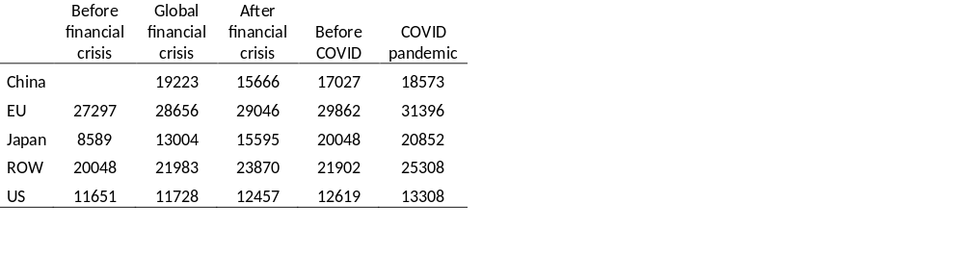
Average employment across regions and time

Slide 22
Econometric results:
sectoral decomposition

Slide 23
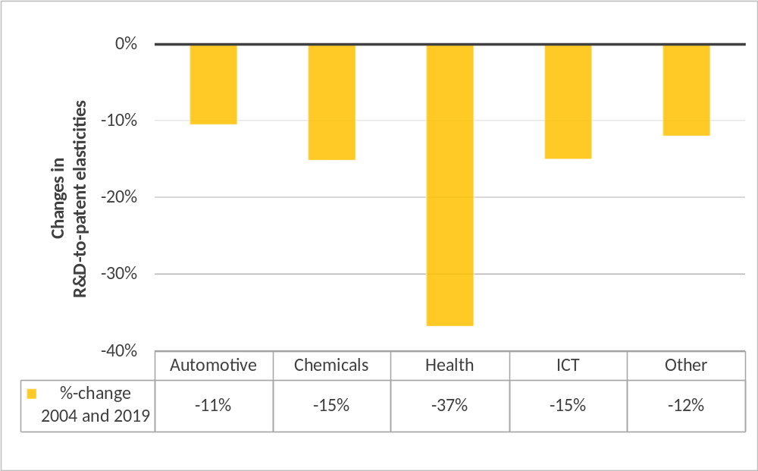
Estimated total decline in R&D-patent elasticity (2004*-2019) across sectors

Slide 24
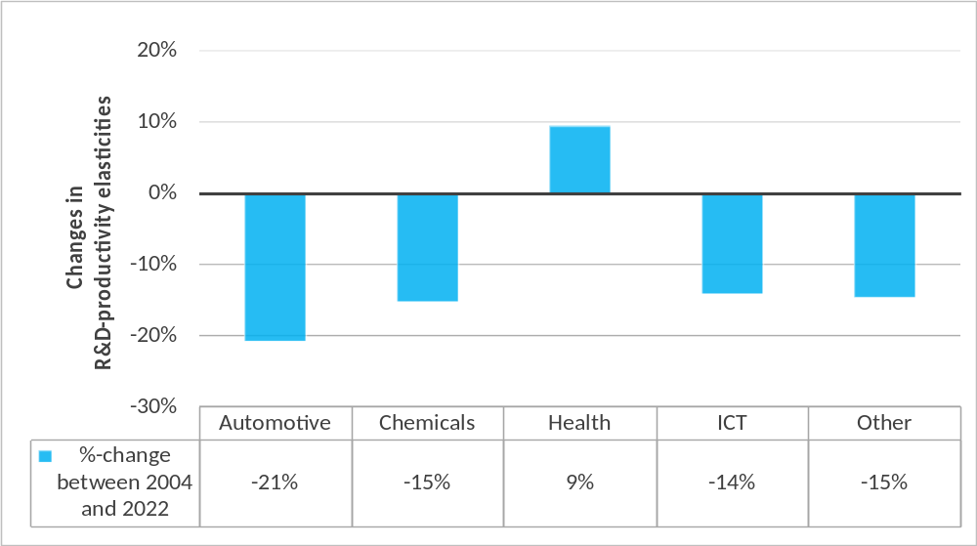
Estimated total decline in R&D-labour-productivity elasticity (2004*-2022) across sectors

