Slide 1





From Interdisciplinary Research to Productive Interactions:
Assessing the Societal Impact of Interdisciplinarity in the
Social Sciences & Humanities
ECOOM policy day, Brussels, 21st October 2025
Eugénie Delzenne, Tim C.E. Engels, Joshua Eykens, Raf Guns,
Eline Vandewalle, Johanna Vanderstraeten, Hendrik Slabbinck

Slide 2
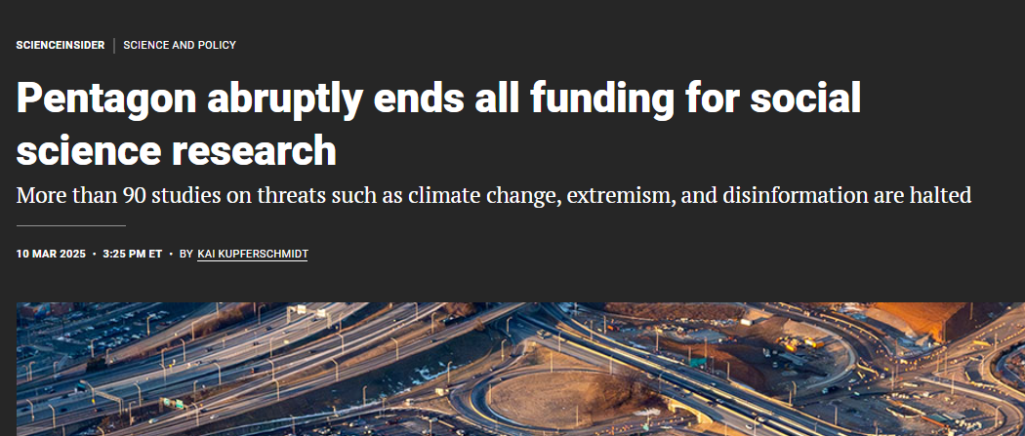
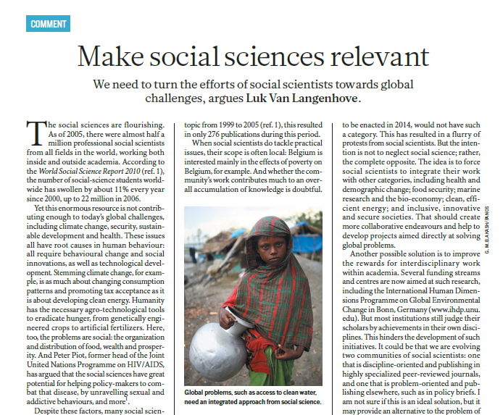

Social Sciences & Humanities (SSH) research under pressure

Slide 3

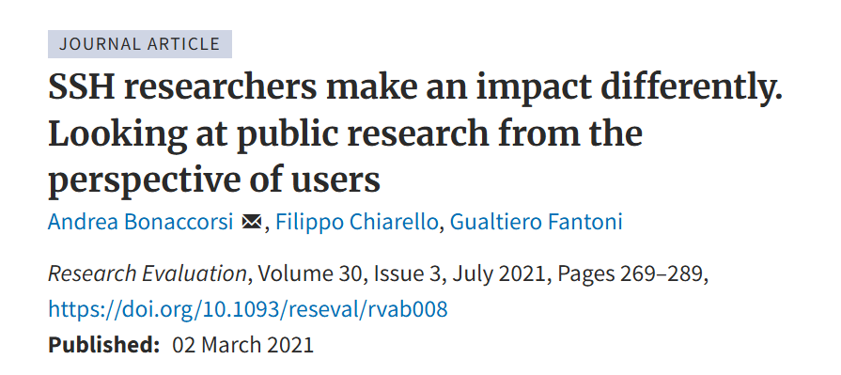
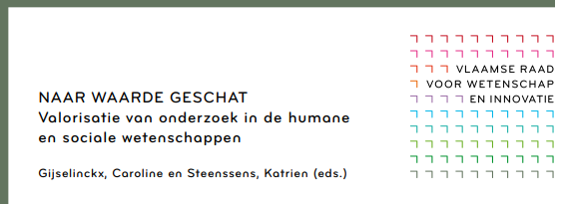
Assessing the societal impact of SSH research
SSH make an impact through productive interactions with non-academic actors.
Productive interactions in the SSH context are different from those in STEM.

Slide 4







Productive interactions in SSH
Activities
Modes
Consultancy & technical advice
RESPONSE
Contract research
Training
Books written for general audiences
DISSEMINATION
Publications for professional or general audiences
Cooperative networks
COOPERATION
Adapted from Cunningham et al. (2024)
CO-PRODUCTION
Joint research/ co-publications

Slide 5

The promise of interdisciplinarity
Interdisciplinarity: a “mode of research that integrates concepts or theories, tools or techniques, information or data from different bodies of knowledge” (Yegros-Yegros et al., 2015, p. 7).
Interdisciplinarity is assumed to enhance creativity and enable groundbreaking discoveries.
Does interdisciplinarity increase productive interactions in the SSH context?

Slide 6
Interdisciplinarity as a catalyst for productive interactions
MECHANISMS
SOCIAL CAPITAL
BOUNDARY-SPANNING ABILITIES
ROLE IDENTITY
Hypothesis 1. SSH researchers who are more interdisciplinary are more likely to be involved in productive interactions.

Slide 7
Knowledge flow directionality
COOPERATION
CO-PRODUCTION
Bi or multidirectional
DISSEMINATION
RESPONSE
Unidirectional
Goal specificity
Low
High
Adapted from D’Este et al. (2019)

Slide 8
Hypothesis 2. Interdisciplinarity is especially conducive to productive interactions involving bidirectional knowledge flows.
Knowledge flow directionality
COOPERATION
CO-PRODUCTION
Bi or multidirectional
DISSEMINATION
RESPONSE
Unidirectional
Goal specificity
Low
High
Adapted from D’Este et al. (2019)
Hypothesis 3. Interdisciplinarity is especially conductive to productive interactions characterised by high goal specificity.

Slide 9
Method & data
4520 researchers affiliated to Flemish universities with 5+ publications (2017-2022) in the Flemish Academic Bibliographic Database for the Social Sciences and Humanities (VABB-SHW).
Data sources: VABB-SHW, Cultuurconnect, FRIS portal, university websites
Interdisciplinarity (Hill-type diversity score): how interdisciplinary a researcher’s work is, based on the spread of their publications across different disciplines.
Modes of productive interactions:
  Response: (Co-)supervision of Strategic Basic Research project(s) (SBO-FWO)
  Dissemination: Authorship of book(s) aimed at general audiences
  Cooperation: Involvement in an endowed chair (leerstoel)
  Co-production: Co-authorship of publication(s) with non-academic stakeholders

Slide 10
Sample characteristics
 |  |  | Interdisciplinarity
 |  |  | Interdisciplinarity
 | N | % | Mean
Response (SBO project (co-)supervision)
No | 4391 | 97.15 | 3.271
Yes | 129 | 2.85 | 3.574
Cooperation (Formal endowed chair involvement )
No | 4436 | 98.14 | 3.279
Yes | 84 | 1.86 | 3.303
Dissemination (Book(s) for general audiences)
No | 2924 | 64.69 | 3.392
Yes | 1596 | 35.31 | 3.074
Co-production (Co-publication(s) with non-academic actors)
No | 3365 | 74.45 | 3.243
Yes | 1155 | 25.55 | 3.387
Full sample | 4520 | 100 | 3.28
Notes:
Sample:
4520 researcher from Flemish universities with at least 5 publications in VABB
Time frame 2017-2022
1835 female researcher 2685 male researchers

Slide 11
Interdisciplinarity stimulates all modes but Dissemination
Response mode
+18.2% (OR = 1.182***)
Dissemination mode
-10.5% (OR = 0.895***)
Interdisciplinarity
+3.4% (OR = 1.034.)
Cooperation mode
+4.5% (OR = 1.045.)
Co-production mode
OR = 1.182 means that for every 1 unit increase in interdisciplinarity, the likelihood of engaging in the mode increases by 18.2%.

Slide 12
Results
Hypothesis |  | Results
1 | Interdisciplinarity stimulates productive interactions. | It depends
2 | Interdisciplinarity is especially conducive to productive interactions involving bi or multidirectional knowledge flows. | Supported
3 | Interdisciplinarity is especially conductive to productive interactions characterised by high goal specificity. | Supported

Slide 13
Some takeaways for policy & practice
Researchers who cross disciplinary boundaries are also more likely to engage with non-academic organisations.
Policy: This suggests that the practice of interdisciplinarity should be encouraged:
  To help researchers be comfortable outside of their comfort zone (bi-directionality)
  To support a continued research focus on societal relevance (goal specificity)
Non-academic organisations: Interdisciplinary researchers as ideal academic partners due to their collaborative capacity and focus on applying knowlegde to real-world problem?
Notes:
The study nuances prior assumptions about the link between interdisciplinarity and societal impact, highlighting contigence upon modes of productive interactions, but overall..

Slide 14
Measuring interdisciplinarity
Hill diversity score: measures how interdisciplinary a researcher’s work is, based on the spread of their publications across different disciplines.
Two dimensions:
  Variety: the number of different disciplines in which a researcher has published
  Evenness: how equally a researcher’s publications are distributed across those disciplines
Discipline(s) of a publication are based on the cognitive classification.
Computed at researcher level (2017-2022), based on publications indexed in the Flemish Academic Bibliographic Database for the Social Sciences and Humanities (VABB-SHW).
Notes:
Measuring IDR:
Hill diversity score: measures how interdisciplinary a researcher’s work is, based on the spread of their publications across different disciplines. A higher Hill diversity score means the researcher is publishing in more disciplines and doing so in a more balanced way — a sign of stronger interdisciplinarity. A lower score means their work is concentrated in fewer fields, or dominated by one main discipline.
Two dimensions:
Variety: the number of different disicplines in which a researcher has published, reflecting the range of fields covered
Evenness: how equally a researcher’s publications are distributed across those disciplines, reflecting the balance between them
Discipline(s) of a publication are based on the cognitive classification, derived from the journal’s or volume’s classification based on its contents.
Computed at researcher level for the time period 2017-2022, based on publications indexed in the Flemish Academic Bibliographic Database for the Social Sciences and Humanities (VABB-SHW).

Slide 15
Activity | Knowledge flow | Goal specificity | Mode | Definition
Consultancy & technical advice | Unidirectional | High | RESPONSE | Activities in which academic researchers transfer or generate new knowledge in response to the needs of non-academic stakeholders
Contract research | Unidirectional | High
Training | Unidirectional | High
Books written for general audiences | Unidirectional | Low | DISSEMINATION | Broad public sharing of research results, aimed either at professionals or at communication of public utility
Publications | Unidirectional | Low
Cooperative networks | Bidirectional | Low | COOPERATION | Cooperative network activities structured around interpersonal relationships between universities and non-academic stakeholders
Joint research | Bidirectional | High | CO-PRODUCTION | Activities in which academic and non-academic stakeholders jointly generate knowledge through collaborative processes
Notes:
Table of activities
Based on these dimensions – we cluster the different activities into 4 modes:
Cooperation mode – characterised by bidirectional knowledge flows and low goal specifity, which we define as Cooperative network activities structured around interpersonal relationships between universities and non-academic stakeholders
Co-production mode - characterised by bidirectional knowledge flows and high goal specificity: Activities in which academic and non-academic stakeholders jointly generate knowledge through collaborative processes
Dissemination mode – characterised by unidirectional knowledge flows and low goal specificity: Broad public sharing of research results, aimed either at professionals or at communication of public utility
Response mode – characterised by primarily unidirectional knowledge flows and high goal specificity: Activities in which academic researchers transfer or generate new knowledge at the explicit request of non-academic stakeholders

Slide 16
Differentiation across modes of productive interaction
Knowledge flow directionality
COOPERATION
CO-PRODUCTION
Bi or multidirectional
DISSEMINATION
RESPONSE
Unidirectional
Goal specificity
Low
High
Adapted from D’Este et al. (2019)
Goal specificity
Low
Instigating societal change
High
Answering specific knowledge needs

