Slide 1
Evolution of Flemish Bilateral and Multilateral Scientific Collaboration in a Volatile world
Eline Vandewalle and Tim Engels
ECOOM, University of Antwerp,
Antwerp, Belgium

Slide 2
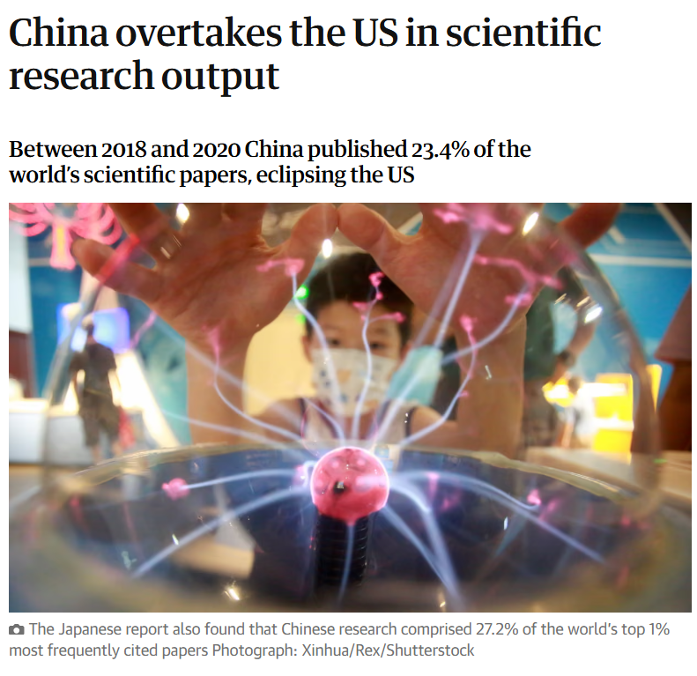
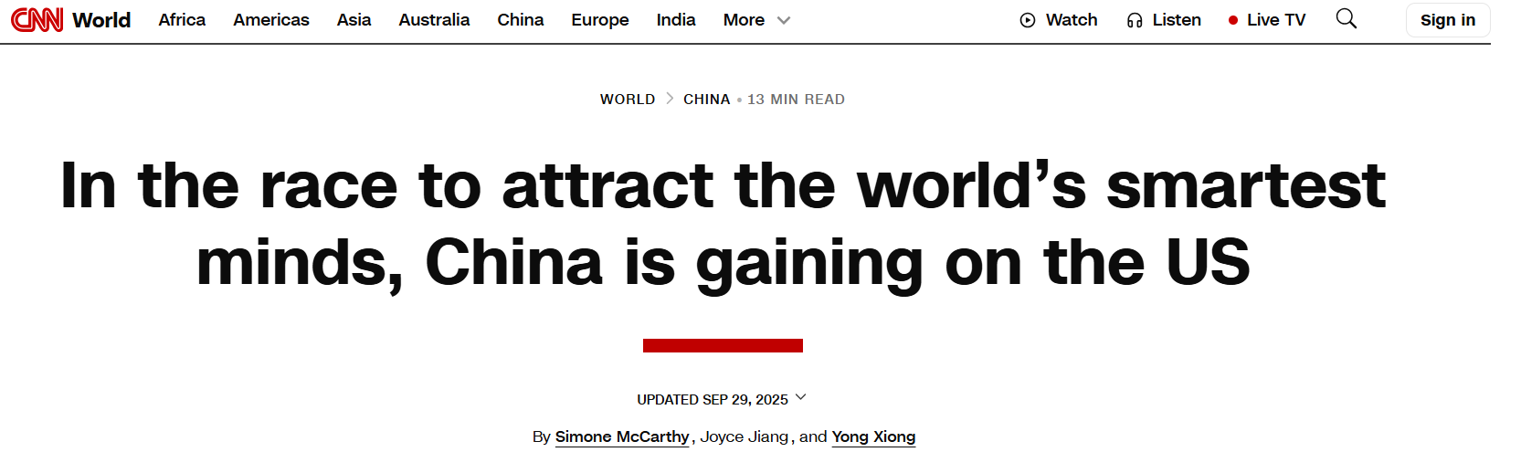
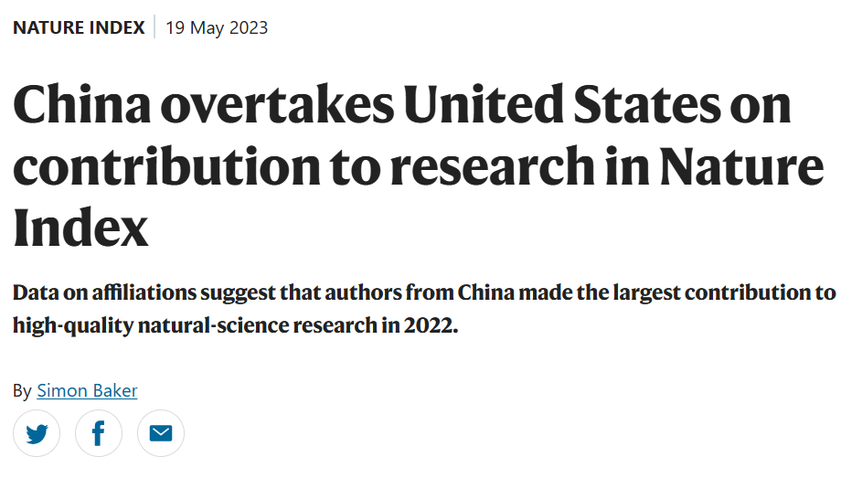
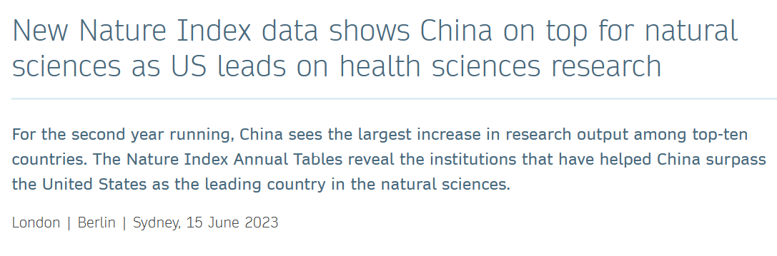
Global Trends – US and Chinese research systems

Slide 3
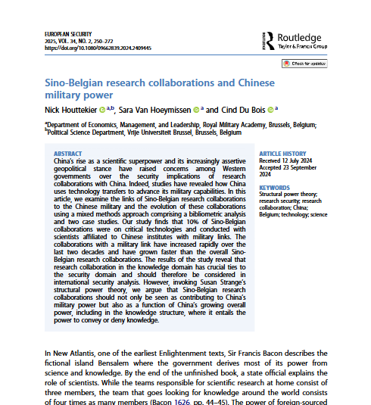
Belgian collaboration with China
Increase in Sino-Belgian collaborations?
Houttekier, N., Van Hoeymissen, S., & Du Bois, C. (2025). Sino-Belgian research collaborations and Chinese military power. European Security, 34(2), 250–272. https://doi.org/10.1080/09662839.2024.2409445

Slide 4



Data
Web of Science data (ECOOM KU Leuven dataset)
  Science Citation Index Expanded
  Social Sciences Citation Index
  Arts and Humanities Citation Index
Years 2000-2024
Universiteit Antwerpen
TU Delft

Slide 5
Belgian collaboration patterns – bilateral and multilateral
Bilateral collaboration
Paper written by authors from 2 different countries
Multilateral collaboration
Paper written by authors from at least 3 different countries

Slide 6
Evolution of Belgian international collaboration

Slide 7
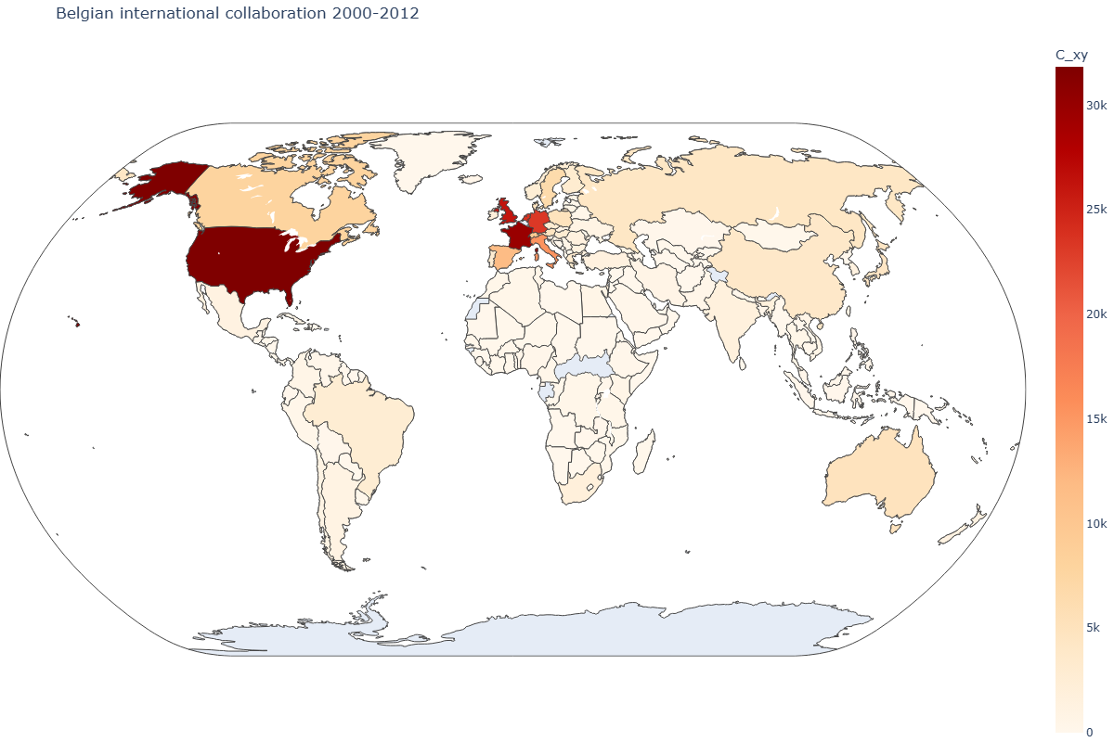
Important partners on a global scale (2000-2012)

Slide 8
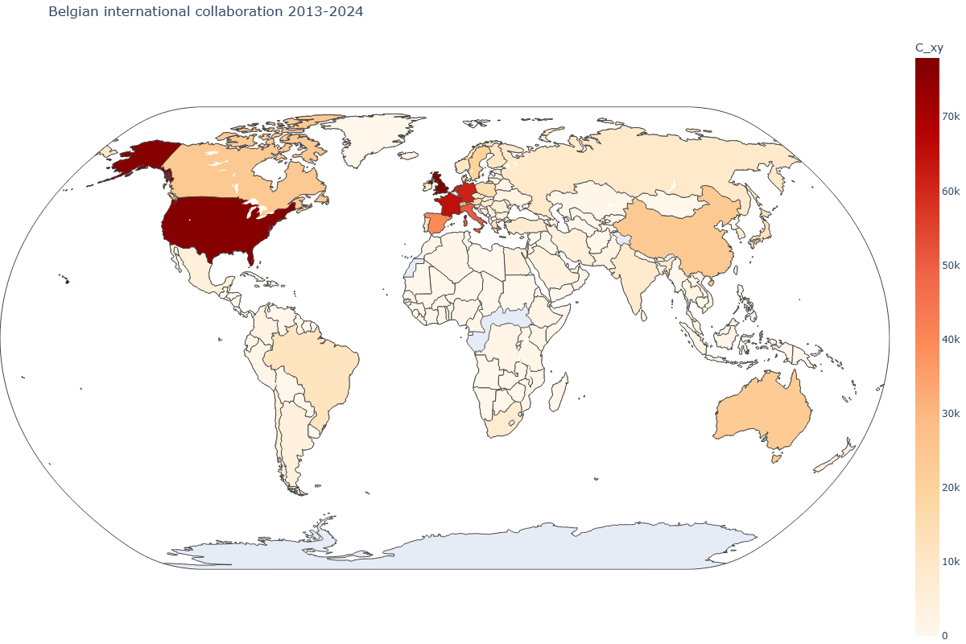
Important partners on a global scale (2013-2024)

Slide 9
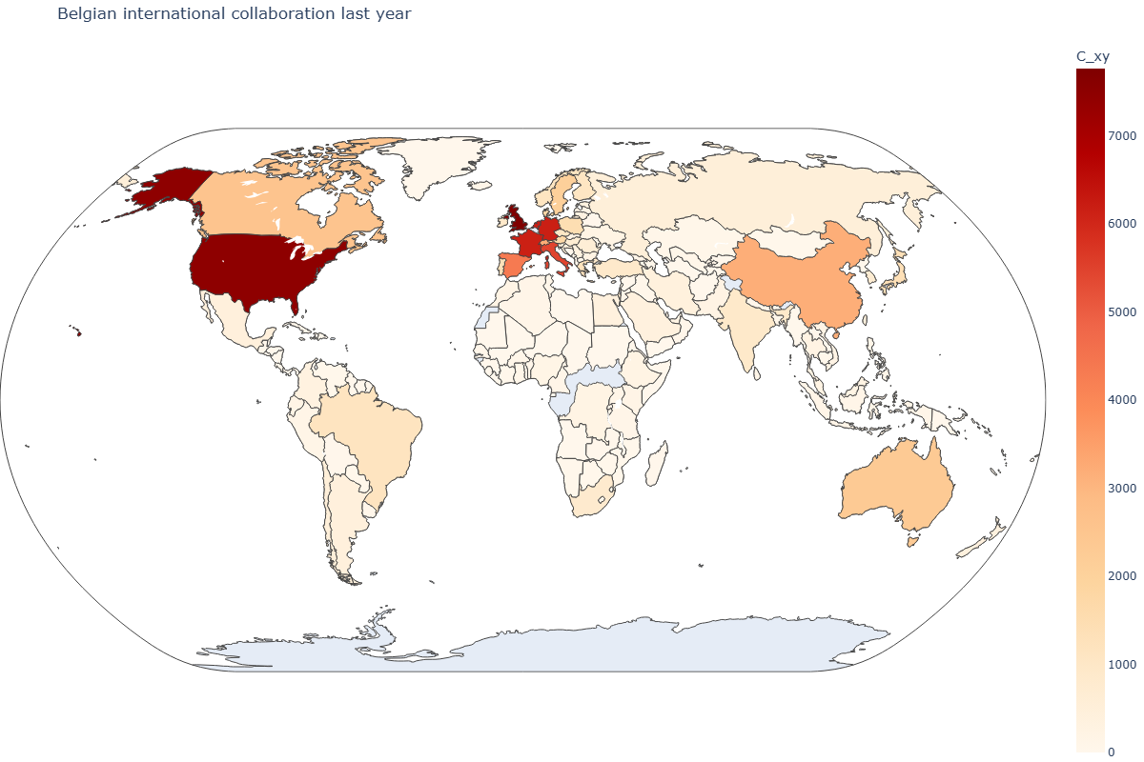
Important partners on a global scale last year

Slide 10
Important partners on a global scale last year

Slide 11
Trends in absolute numbers

Slide 12
The Relative Intensity of Collaboration (RIC)
Beyond the absolute numbers

Slide 13
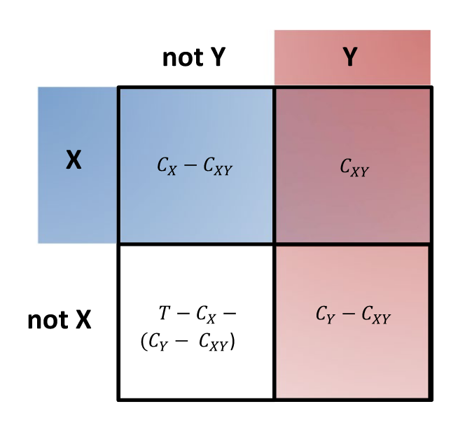
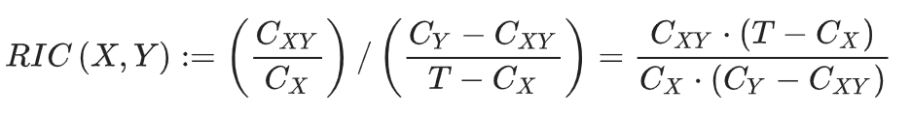
Beyond the absolute numbers
The US and China are both important partners in collaboration (they are the largest scientific world-powers)
  Lets take into account the relative sizes of each countries’ research system
The Relative Intensity of Collaboration (RIC)
Fuchs, J. E., Sivertsen, G., & Rousseau, R. (2021). Measuring the relative intensity of collaboration within a network. Scientometrics, 126(10), 8673–8682. https://doi.org/10.1007/s11192-021-04110-x
Engels, T. E., Rousseau, R., & Zhou, H. (2025, September 3–5). The relative intensity of bilateral and multilateral co-authorship with Russia since 1995. Paper presented at the STI-Enid Conference 2025, Bristol, United Kingdom.

Slide 14
RIC between Belgium and neighbouring countries
Bilateral
Multilateral

Slide 15
Flanders – RIC with Neighbours
Bilateral
Multilateral

Slide 16
RIC between Belgium, the US, UK and China
Bilateral
Multilateral

Slide 17
RIC with between Flanders the US, UK and China
Bilateral
Multilateral

Slide 18
What will the future bring?

Slide 19
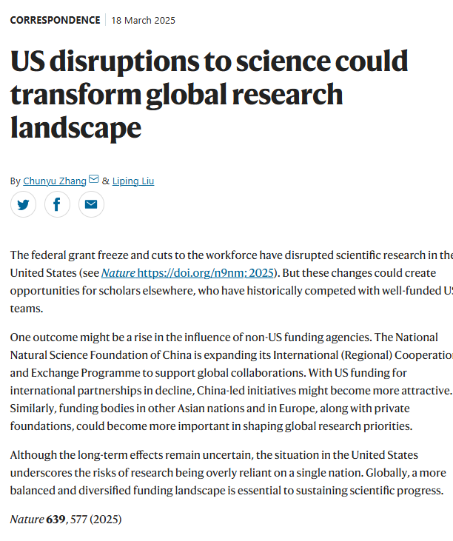
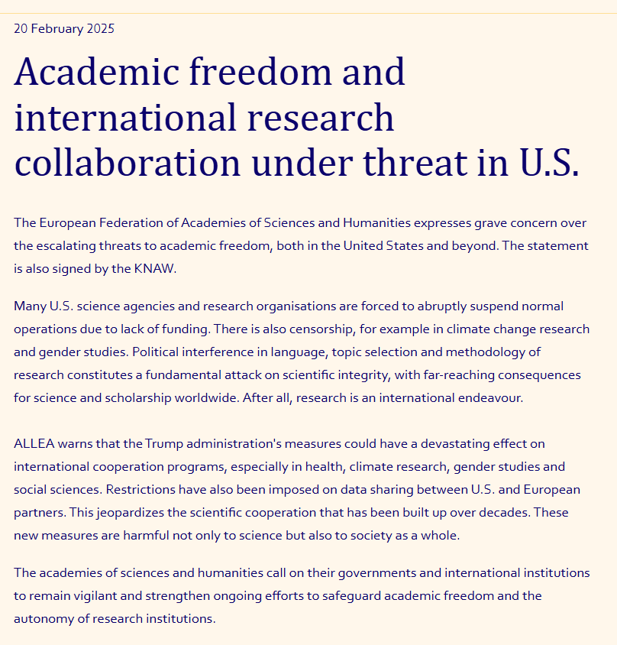
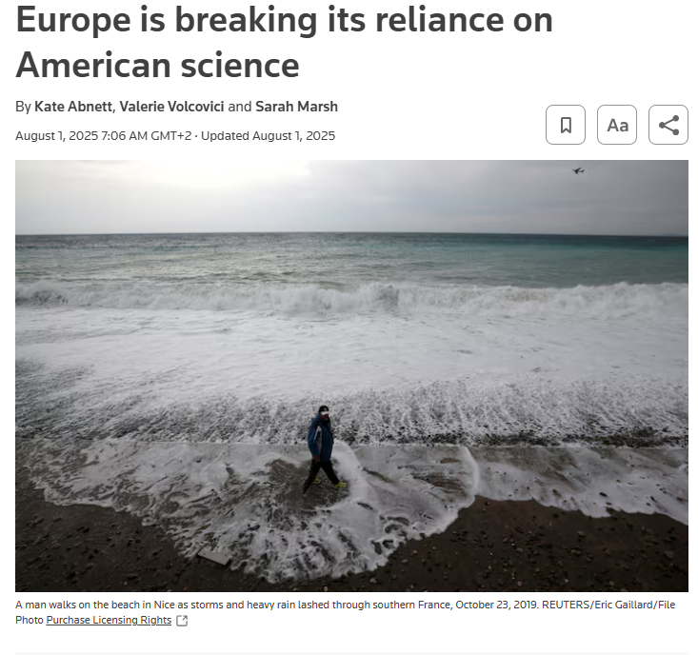
Recent shifts in US science policy
Koninklijke Nederlandse Academie van Wetenschappen
Nature
Reuters

Slide 20
Conclusion
Belgian and Flemish international scientific collaboration is increasing
  We can distinguish between bilateral and multilateral collaboration
  Mainly multilateral collaboration is increasing
China is becoming more imporant as a scientific partner
However, relative intensity of collaboration remains stronger for
  Neighbouring countries (especially the Netherlands)
  The UK
  The US

Slide 21
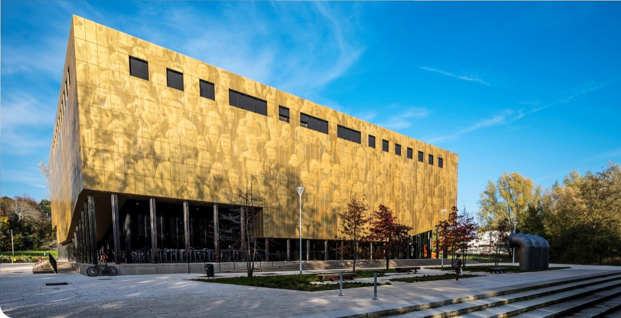
Thank you for your attention
Feel free to reach out:
Eline.Vandewalle@UAntwerpen.be

