Slide 1
Resilience of Flemish academic ties in a disruptive era
Prof dr Bart Thijs

Slide 2
Introduction
Research in a disruptive era
Rapid technological, geopolitical, environmental, and social shifts are transforming how science operates.
Traditional assumptions of open collaboration, mobility, and stability are being challenged.
Data flows, funding priorities, and access to infrastructures face increasing uncertainty.
Researchers worldwide experience an altered reality — where disruption is the new normal.

Slide 3
Introduction
Academic ties
Not only individual partnerships, but also system-level connections among institutions, regions, or countries.
Captured through co-authorship networks, joint funding, or shared infrastructures.
These ties underpin global knowledge production, enabling diffusion of expertise and innovation.
Disruptions may alter who collaborates with whom, potentially reshaping the geography of science

Slide 4
Introduction
Resilience in Science Systems
In this context, resilience ≠ resistance, but adaptability and recovery after disruption.
A resilient system maintains its collaborative intensity and visibility despite global disturbances.
Measuring resilience requires observing recovery after real disruptions — often unfeasible.

Slide 5
Introduction
Resilience in Science Systems vs Economic resilience
Knowledge Creation / Collaborative networks
Input / Output is of discrete or even singular
Disruptive event: drop in availability of network
Recovery: restore of knowledge creation and exchange
Production / supply chains.
Input / Output is of continuous nature
Disruptive event: drop at input side
Recovery: return to normal output level

Slide 6
From Resilience to Vulnerability Mapping
Instead, focus is on vulnerability, the degree to which a region’s science system is exposed to disruption.
Vulnerability can be measured through changes in bibliometric indicators such as: Publication output, International co-authorship rates, Citation impact, …
Vulnerability is modeled by selectively removing collaborative links or papers and observing system response.
This approach reveals structural dependence: does a region rely strongly on external partners for their scientific output and visibility.

Slide 7
A Network Approach to Simulated Disruption
Percolation simulates cascading losses in publication output when external collaborators become unavailable.
The network consists of two node types:
  Authors (each linked to a specific region)
  Papers (connected to all their co-authors).
A disruption removes authors from a given region → this cascades to the papers they contribute to.
A paper is removed if a certain share of its authors are lost.

Slide 8
Simulated Disruption at different levels
The sensitivity parameter defines how much author loss a paper can sustain before disappearing.
Three levels capture different disruption intensities:
Scenario | Threshold for removal | Interpretation
High Sensitivity | 25% | Fragile system, papers depend heavily on the partner country
Medium Sensitivity | 50% | Moderate robustness partial losses are tolerated
Low Sensitivity | 75% | Papers survive major author loss

Slide 9
Quantifying Regional Exposure
Three bibliometric indicators:
Production: number of papers (in Web Of Science)
Journal based impact: Relative Citation Rate
Field based impact: Share of highly cited papers (in CSS class 3 and 4)
The relative decline quantifies exposure to disruption.
High losses = high exposure / vulnerability / dependency
Low losses = resilience

Slide 10
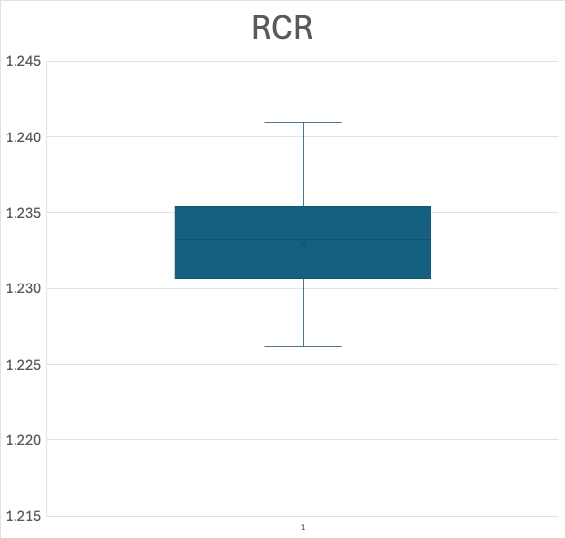

Baseline: Random paper removal
To isolate systemic sensitivity, 10% of the Flemish publications were randomly removed. This procedure was repeated 25 times to capture variation due to stochastic loss.

Slide 11
Quantifying Regional Exposure
Vulnerability of Flanders is assessed relative to disruptions in a few key science systems.
🇺🇸 United States – globally central and highly collaborative
🇬🇧 United Kingdom – dense European and transatlantic ties
🇩🇪 Germany & 🇫🇷 France – key players in EU and global collaboration
🇮🇱 Israel – smaller but deeply internationalized science system
These countries represent different positions in the global network.

Slide 12
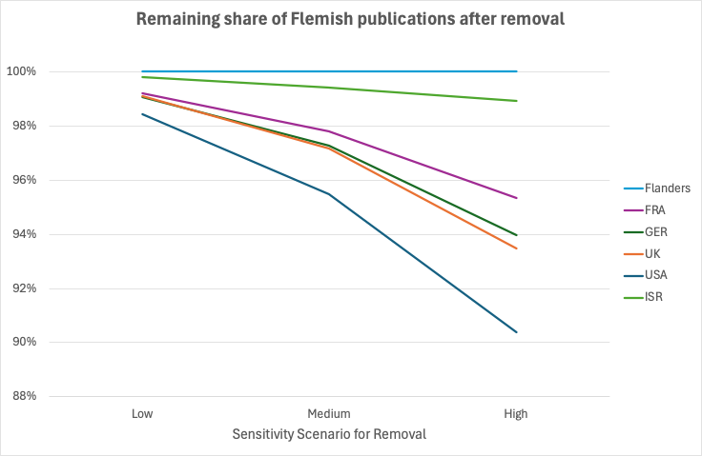
Impact of percolation on Publication

Slide 13
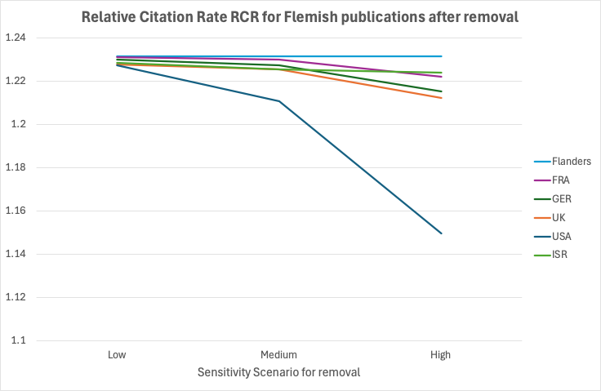
Impact of percolation on Impact

Slide 14
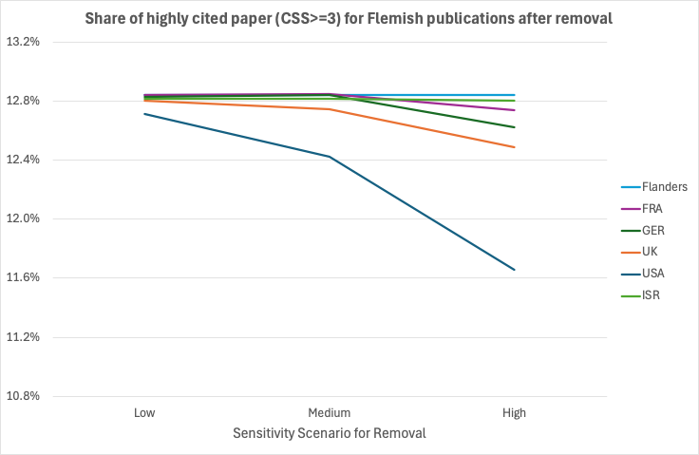
Impact of percolation on Impact

Slide 15
Regional Exposure by partner country
High exposure to the United States: all three indicators show large declines under disruption.
Moderate exposure to the United Kingdom: smaller but noticeable impact across indicators.
Germany and France: significant effects only under high-sensitivity scenarios (25 % threshold).
Israel: minimal impact; percolation barely alters bibliometric indicators, reflecting low dependency.

Slide 16
Vulnerability Analysis in a Key Scientific Domain
Focus field: Pharmacology and Pharmacy — economically and socially relevant for Flanders.
The same percolation methodology is applied:
  Bipartite author–paper network
  Partner-country–specific removal
  Three sensitivity thresholds (25 %, 50 %, 75 %)
Research question: Is Flanders more or less vulnerable in this domain compared to overall science?

Slide 17
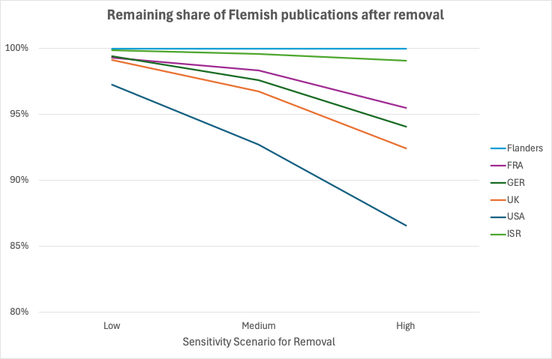
Impact of percolation on Publication

Slide 18
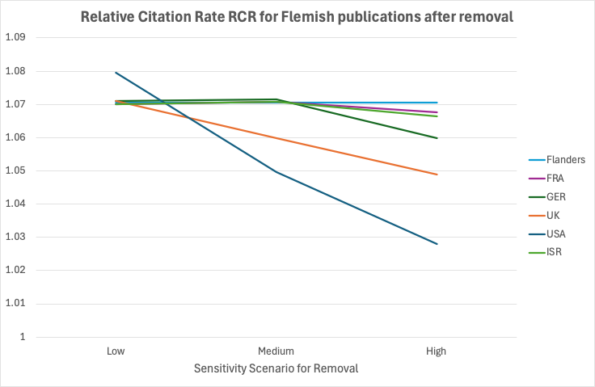
Impact of percolation on Impact

Slide 19
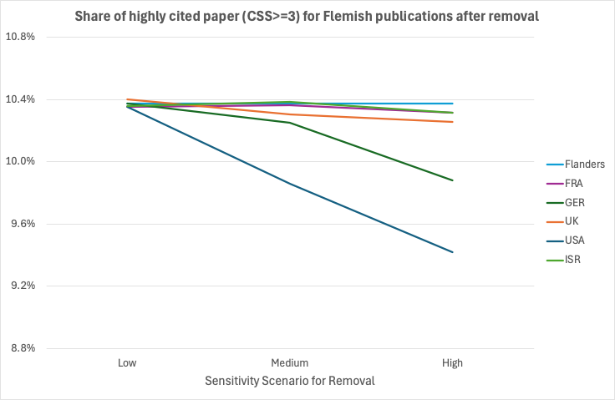

Impact of percolation on Impact

Slide 20
Key Takeaways
Preliminary findings reveal patterns of vulnerability in the Flemish regional science system, but the analysis is still in its early stages:
Differing levels of vulnerability depending on partner country and sensitivity scenario.
US and UK collaborations have the strongest impact; Germany and France matter under high-sensitivity; Israel has minimal influence.
The effect will vary by discipline — e.g., Pharmacology & Pharmacy, more on publication output, less on citation impact.

Slide 21
Next Steps
Current study is preliminary:
Only a small set of partner countries analyzed
An overall, country-wide percolation is highly unlikely
Next steps:
Expand the percolation analysis to a broader set of countries, disciplines, and sensitivity thresholds
Replace country-based percolation by more targeted removal of authors based on disruptive events in partner countries

