Slide 1
The innovation performance of EU regions.
Real effects of Artists?
Bergamini, M. , Sleuwaegen, L. , Van Looy, B.
KU Leuven, Department of Management, Strategy and Innovation
Flanders Business School (by KU Leuven)

Slide 2
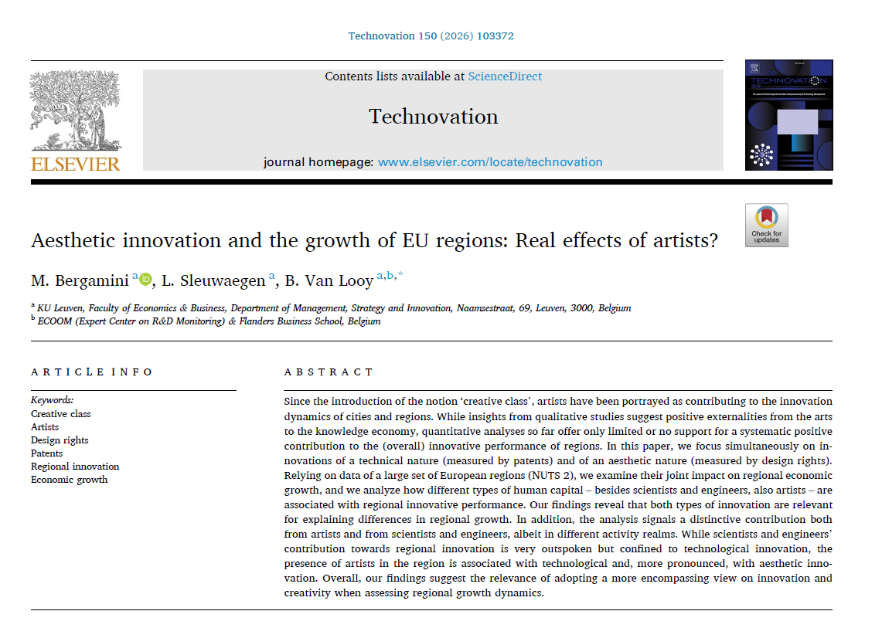

Slide 3

“The Creative Class consists of people who add economic value through their creativity”
(Florida, 2002)
“Artists and musicians have always been the waiters and waitresses at the banquet of life. With his new book, Richard Florida has invited us all to have a seat at the table”
(Art Keeble, Arts Council of Hillsborough County, Florida)

Slide 4
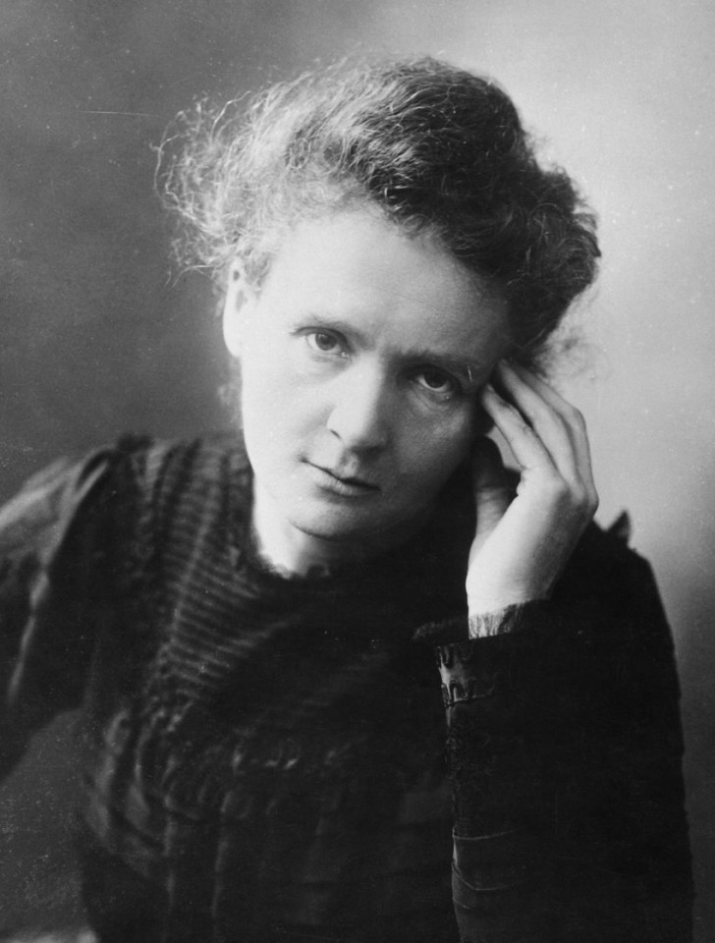
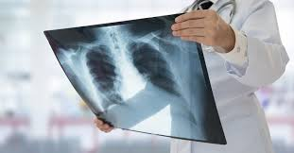

“Market Failures” & “Spill-overs”?

Slide 5
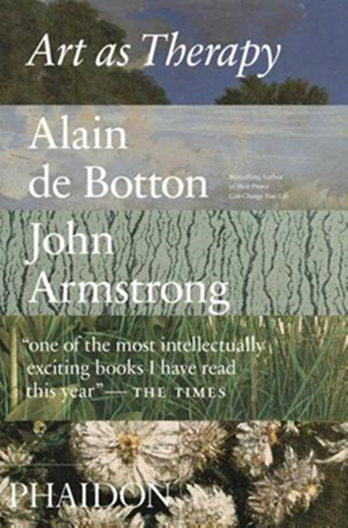

Art and Positive Externalities

Slide 6
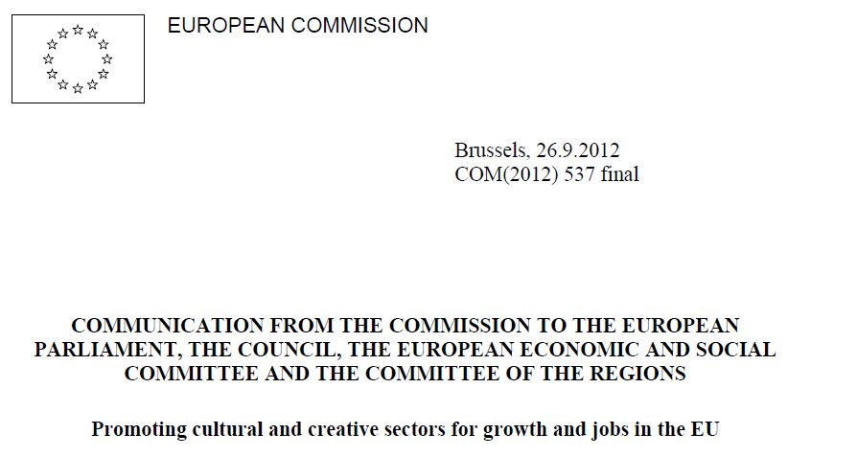
“Being at the crossroads between arts, business and technology, cultural and creative sectors are in a strategic position to trigger spill-overs in other industries. […] More generally, these sectors have an impact on innovation in other industries.”

Slide 7
Do Artists Contribute?
Positive relationship between the presence of artists and innovation – 2 ‘assumed’ channels:
Locational factor attracting high-skilled workers (‘Bohemian Index’ – Florida, 2002) – in line with the literature explaining the demand for cities in terms of access to amenities and consumption externalities (Glaeser et al., 2001; Clark et al., 2002; Shapiro, 2006)
Spillover effects to other industries and sectors – generation of novel ideas and novel recombinations (Florida, 2002; Knudsen and Florida, 2006)

Slide 8
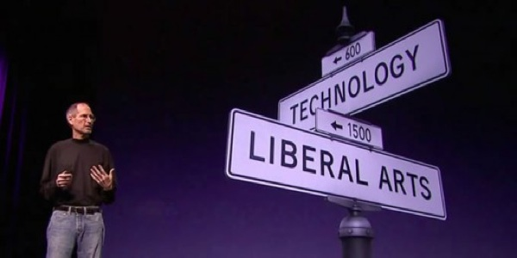
Do Artists Contribute?
“It’s in Apple’s DNA that technology alone is not enough. It's technology married with liberal arts, married with the humanities, that yields the results that make our hearts sing”
(Steve Jobs, Presentation of the iPad 2, March 2010)

Slide 9
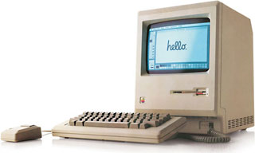
Do Artists Contribute?
“
1984
The Macintosh

Slide 10
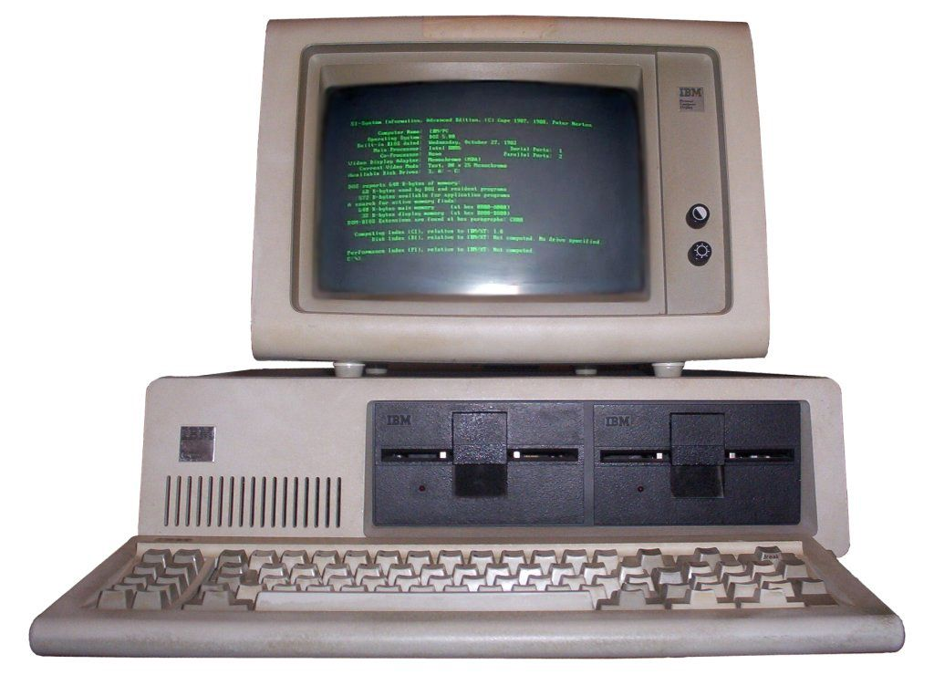
Do Artists Contribute?
“

Slide 11
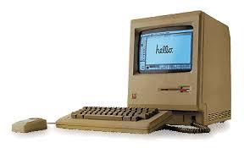
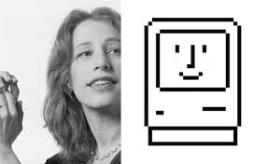
Do Artists Contribute?
“I was living in Palo Alto, welding a life-size razorback hog for a museum in Hot Springs, Arkansas, because I had been really interested in sculpture. This has more to do with me than with the Mac-- but I had thought my ideal life would be to make art full-time. I had the chance to do that with this commission, and I really enjoyed making this sculpture; but it was kind of solitary, so it was interesting for me to segue from that to working at Apple. I liked a lot of the people, and it was a great project, and it was great to be part of the Macintosh effort”
Interview with Susan Kare (‘Making the Macintosh’, Stanford University)
1984
The Macintosh

Slide 12

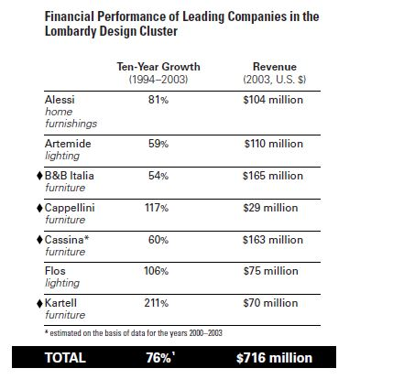
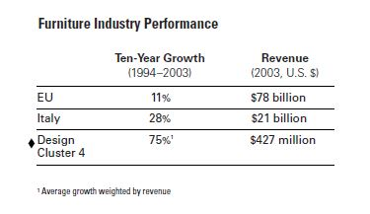
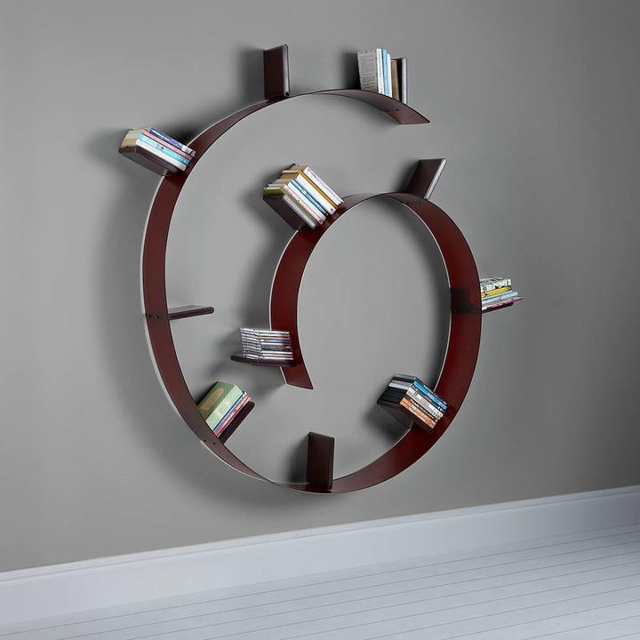
Design-driven / ‘Aesthetic’ Innovation
Source: Verganti, 2006

Slide 13
Do Artists Contribute?
Qualitative studies:
  Spillover effects resulting in better products and services in non-artistic industries (Markusen & Schrock, 2006; Stolarick & Florida, 2006; Currid, 2006, 2007; Verganti, 2006, 2008; Dell’Era & Verganti, 2010; Rindova et al. 2011)
  Quantitative analyses :
  Locational factor: Presence of Creative Core/Creative professionals (Boschma & Fritsch, 2009; Knudsen et al., 2008; Nelson et al., 2015) – positive correlation with the presence of bohemians (Florida’s Bohemian Index)
  Employment growth (Polese, 2012; Boschma & Fritsch, 2009; Tiruneh et al., 2021) – mixed results
  TFP (Marrocu & Paci, 2012) – no effect of bohemians
  GDP per capita (Tiruneh et al. 2021) – negative and significant effect of bohemians
  Innovation (patenting activity) (Boschma & Fritsch, 2009; Knudsen et al., 2008) – no effect of bohemians

Slide 14
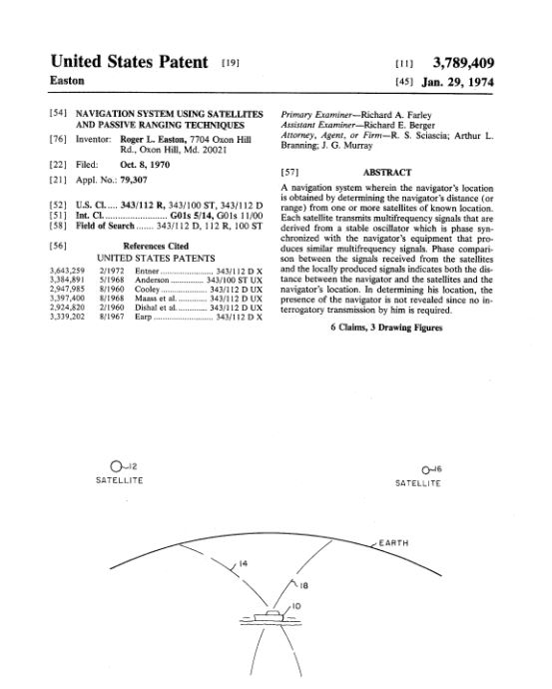
Towards a more encompassing view on innovation
Patents and patent statistics are the most widely used indicator of (technological) innovation
Advantages:
Close relationship with ‘successful’ R&D
Broad accessibility
Detailed information on timing of innovation, inventor(s), applicant(s), citations, technology classes
Limitations:
Not all inventions are patented/patentable
Patents vary greatly in value (hence look at citations, litigations, etc.)
Companies and industries and even geographies vary in their propensity to patent

Slide 15
Towards a more encompassing view on innovation
Patents are unlikely to be the best indicator of innovative activity of a more aesthetic nature (which rely on a more ‘symbolic’ knowledge base)
Design rights have been advanced to complement patents to arrive at a more comprehensive view on innovation (Chan et al., 2017; Filitz et al., 2015; Rubera & Droge, 2013; Alcaide-Marzal & Tortajada-Esparza, 2007) (without claiming a full/comprehensive picture)

Slide 16
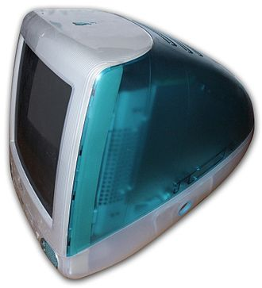
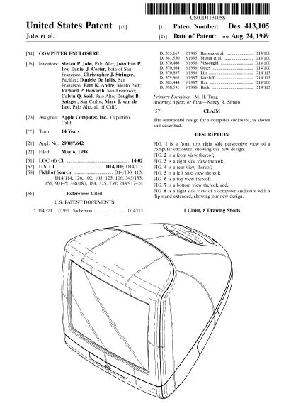
1998 – iMac G3
“The iMac G3 personal computer revolutionized the aesthetics of computers at the end of the 1990s and influenced the shapes and colors of all types of domestic electrical products.” (V&A Museum, London – item description)

Slide 17
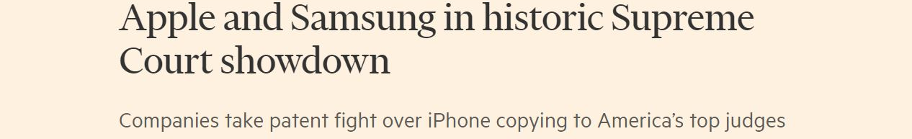
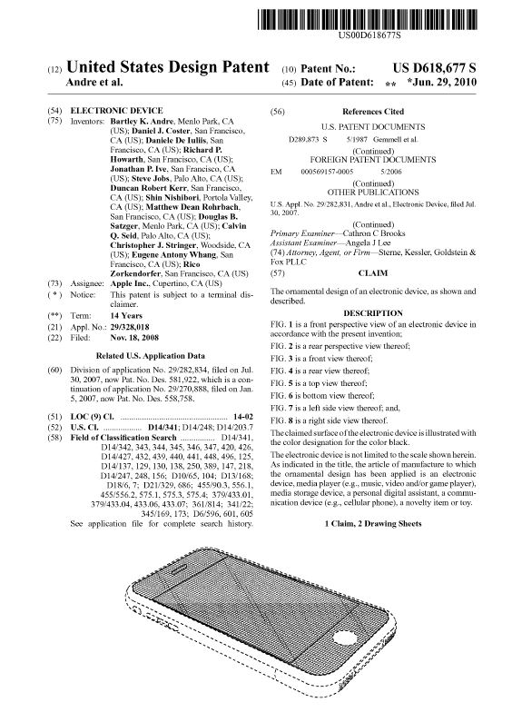
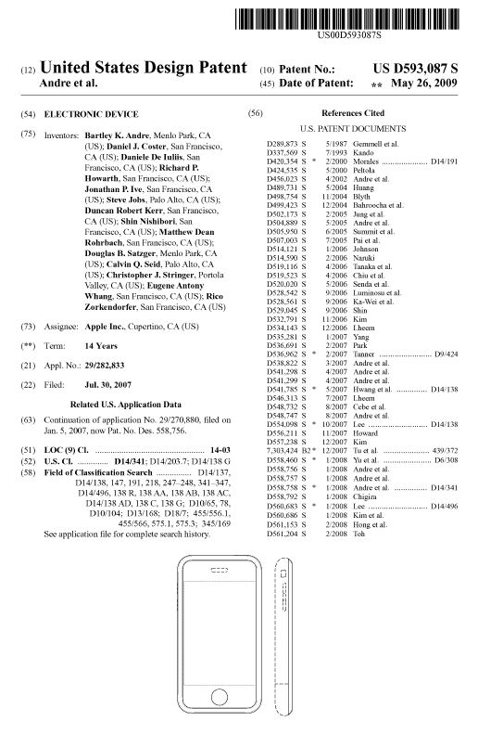
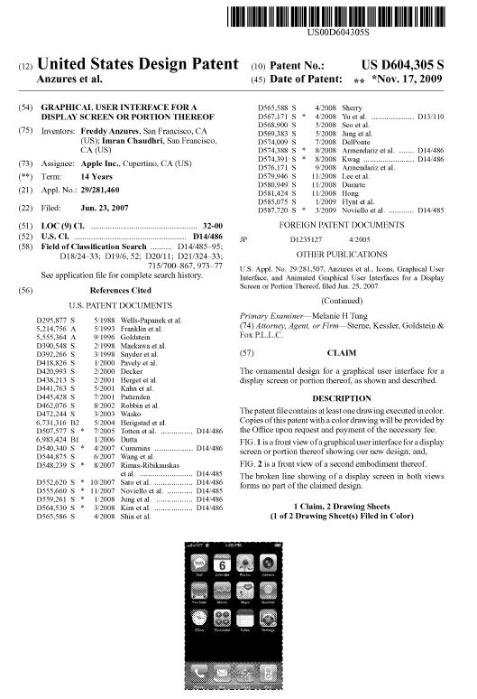
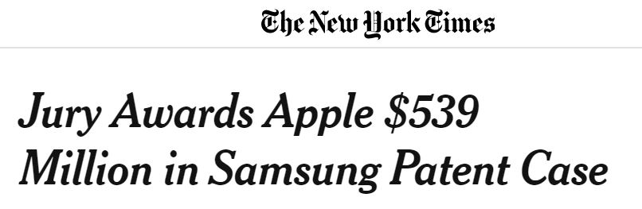

Slide 18
Towards a more encompassing view on innovation
This paper:
Re-assessment of the contribution of artists to regional innovation
Accounting for different innovation types: aesthetic innovation (Chan et el., 2017; Filitz et al., 2015; Eisenman, 2013; Verganiti, 2006; 2008) besides technological innovation;
Does aesthetic/design innovation contribute to regional productivity?
Revisiting ‘creative class’ measures (differential contribution of different professional groups) and their contribution to technological/aesthetic innovation
→ concurrent effects of higher education, the creative class broadly defined as well as its artistic and scientific subcomponents

Slide 19
Regional innovation determinants
Geography of innovation: importance of knowledge spillovers (Audretsch & Feldman, 1996; Zoltan & al., 2002; Acs & Anselin, 2002; Feldman & Florida, 1994; Jaffe, 1989; Acs et al., 1992)
Different innovation outputs will benefit from different knowledge inputs (embodied in different types of human capital)?
  Education
  Creative class
  Which part of the creative class?

Slide 20
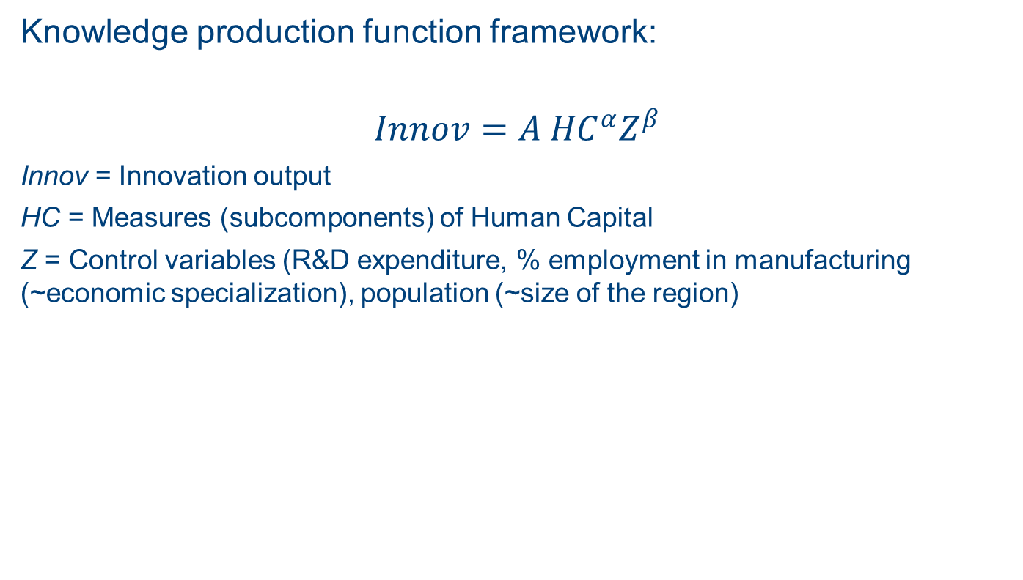
Regional innovation determinants
Knowledge production function framework:
$$Innov=A {HC}^{α}Z^{β}$$
Innov = Innovation output
HC = Measures (subcomponents) of Human Capital
Z = Control variables (R&D expenditure, % employment in manufacturing (~economic specialization), population (~size of the region)

Slide 21
Regional innovation determinants: data
Panel data on 186 NUTS 2 regions (EU15) from 2003 to 2011
Dependent variables:
GDP Growth/capita
Number of patent applications filed annually at EPO per million inhabitants (Patent) (Source: Eurostat regional statistics)
Number of community design applications filed annually at EUIPO per million inhabitants (Design) (Source: Eurostat regional statistics)

Slide 22
Regional innovation determinants: data
Independent variables:
Human capital components (International Standard Classification of Occupations – ISCO-codes) (Florida, 2000; Boschma & Fritsch, 2009; Marrocu & Paci, 2012) :
% of highly educated population
% of creative professions over education (source: EU-LFS)
% of scientists and engineers (S&E – Eurostat definition) over creative class (source: EU-LFS)
% of arts-related occupations over creative class (source: EU-LFS):
  Bohemians (Boschma & Fritsch, 2009; Marrocu & Paci, 2012);
  Artists
Notes:
International Standard Classification of Occupation has been revised in 2008 – data following the new ISCO-08 are available from 2011 onwards

Slide 23
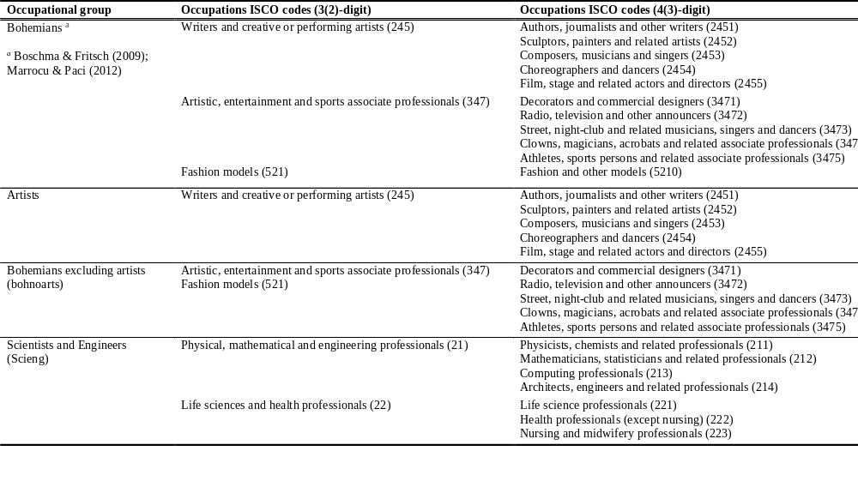
Data

Slide 24
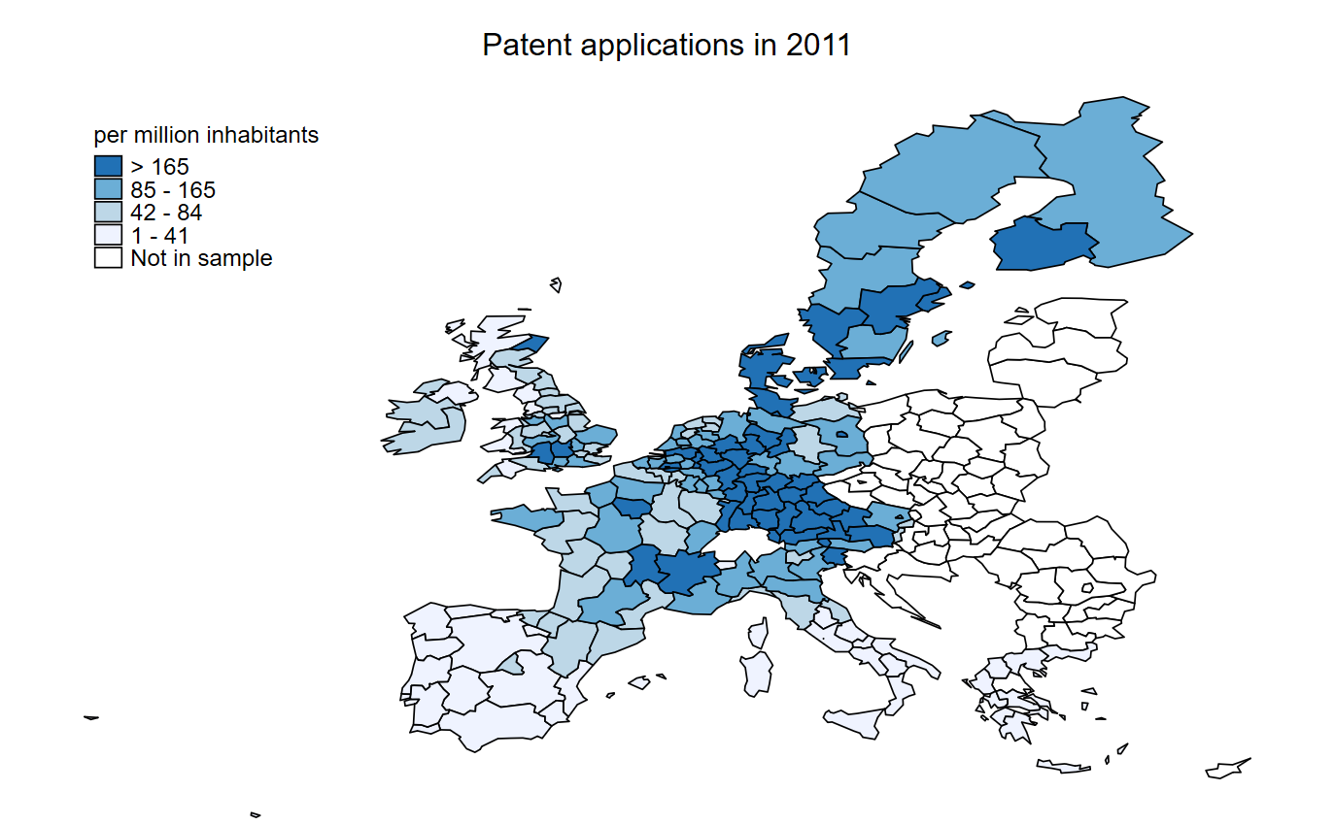
Aesthetic innovation and regional productivity

Slide 25
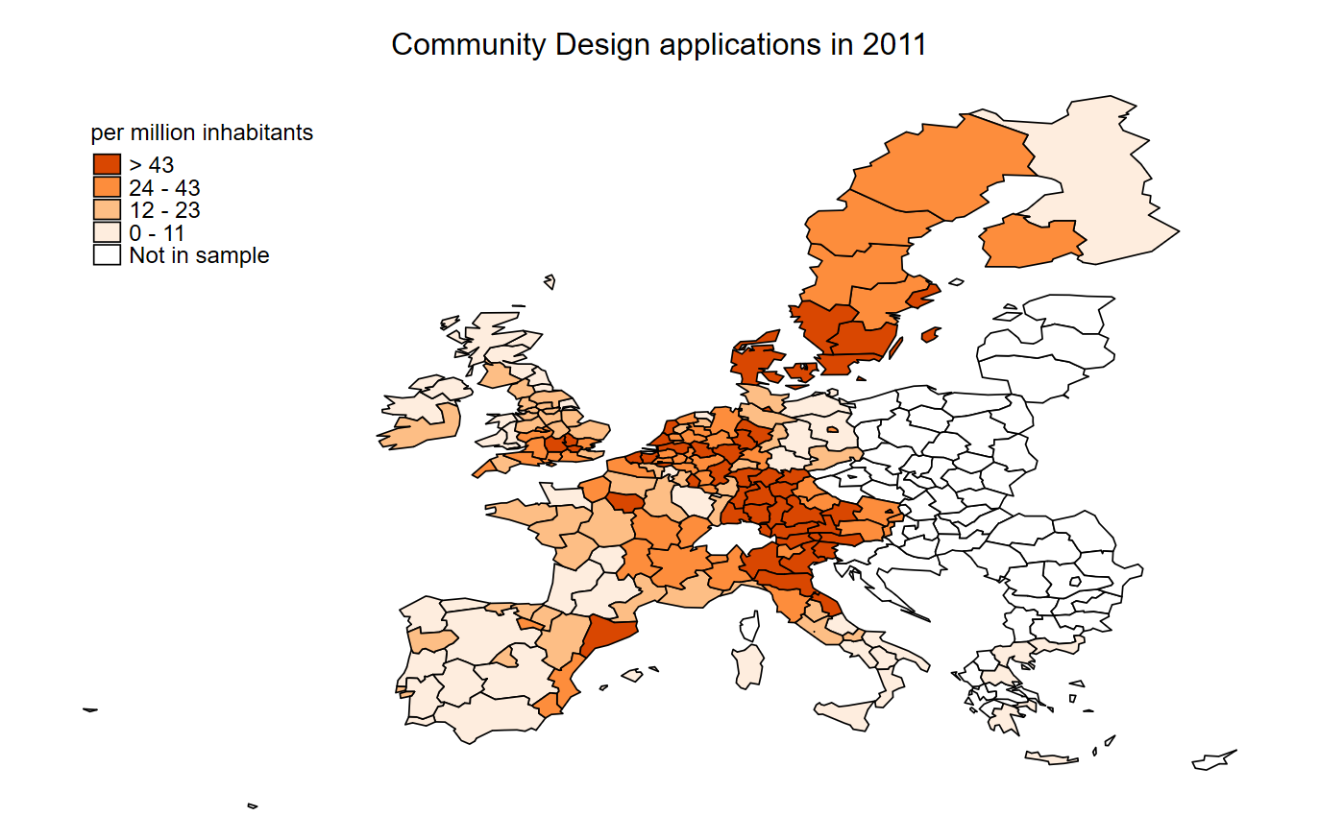
Aesthetic innovation and regional productivity

Slide 26
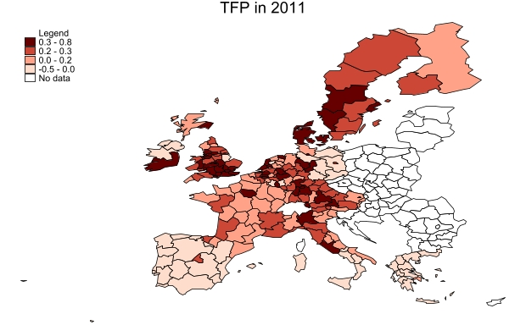
Aesthetic innovation and regional productivity

Slide 27
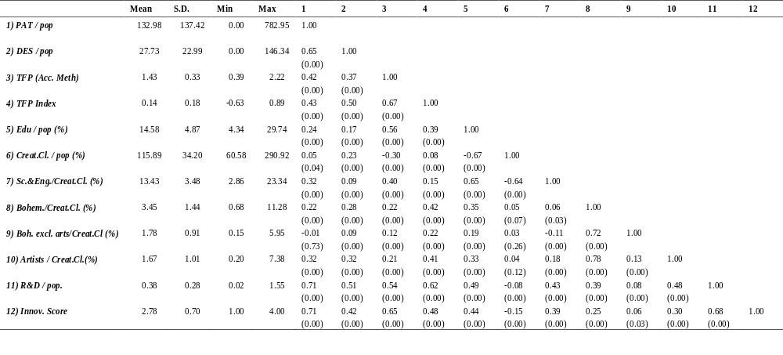

Slide 28
Aesthetic innovation and regional productivity
Abundant evidence on the importance of (technological) innovation as a key driver of productivity and economic growth (Schumpeter, 1954; Hall, 2011; Capello & Lenzi, 2015)
Studies suggest that design and design innovation can also benefit economic performance at the firm and product level (Verganti, 2006; 2008; Filitz et al. , 2015; Eisenman, 2013). Same at the macro level?
We relate growth of GDP to both technological and aesthetic innovation

Slide 29
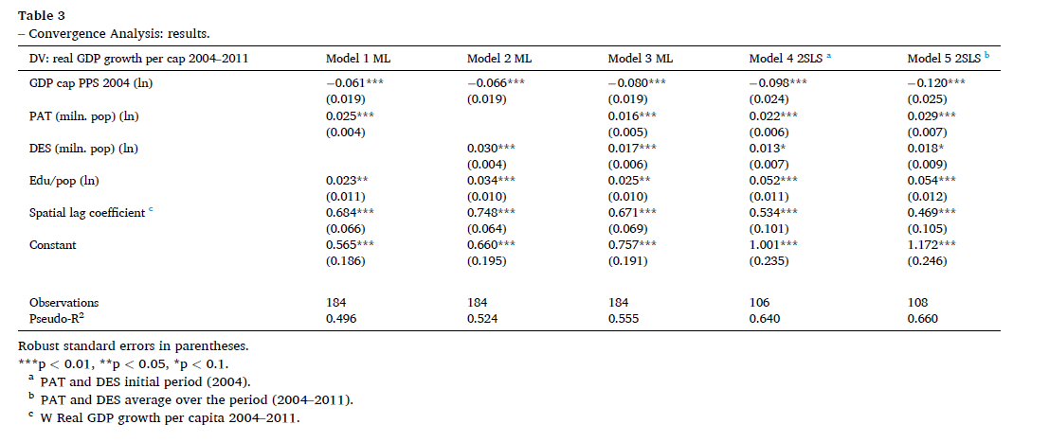

Slide 30
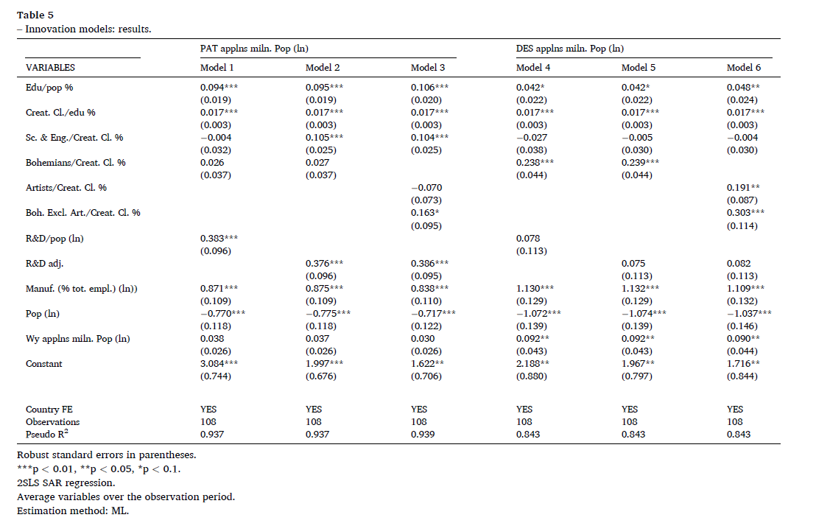

Slide 31
Conclusion
Aesthetic and technological innovation differ in terms of antecedents;
Positive relationship between the presence of scientists and engineers and regional technological innovation;
Positive relationship between the presence of arts-related occupations and aesthetic innovation;
Scientists, Engineers and Designers (we assume - there are also models, athletes,…) do contribute to innovations of a technical nature (whereas artists don’t); the presence of artists seems distinctive for the creation of innovation of an aesthetic nature.

Slide 32
Implications – conceptual/theoretical
Confirming the relevance of (Jane) Jacobs externalities (and some claims advanced by R. Florida)
Relationships only become visible if both innovation outcomes and innovation processes are being conceptualized/operationalized in a distinctive manner.
At that moment, artists do become visible albeit only for innovations of a more symbolic/aesthetic nature.
Extending our view on ‘Innovation Systems’ (meso/macro) as well as on the innovation process (e.g. von Hippel’s Sources of innovation)
Whereas scientists/engineers are contributing to the knowledge frontier, artists are emerging within this study as playing a similar role with respect to meaning.

Slide 33
Limitations and Avenues for Future Research
Include other measures accounting for the presence of arts in a region (e.g. artistic institutions as a measure of ‘cultural/artistic capital’) – heritage or contemporary production or both?
Further investigate the relevant mechanisms at play: inspiration or active engagement (of artists)?
Short term versus long term dynamics (see also Hutter, The Joyful Economy, 2015)

Slide 34
 | PAT applns miln. pop (ln) |  |  | DES applns miln. pop (ln)
 | Model 1 | Model 2 | Model 3 | Model 6 | Model 7 | Model 8
 | OLS | OLS | OLS | OLS | OLS | OLS
Edu / pop % (t-1) | 0.114*** | 0.119*** | 0.120*** | 0.067*** | 0.067*** | 0.069***
 | (0.012) | (0.012) | (0.012) | (0.015) | (0.015) | (0.015)
Creat. Cl. / Edu % (t-1) | 0.017*** | 0.017*** | 0.017*** | 0.018*** | 0.018*** | 0.018***
 | (0.001) | (0.001) | (0.001) | (0.002) | (0.002) | (0.002)
Sc. & Eng. / Creat. Cl. % (t-1) | 0.031** | 0.031** | 0.029** | 0.005 | 0.005 | 0.001
 | (0.013) | (0.013) | (0.013) | (0.017) | (0.017) | (0.017)
Bohemians / Creat. Cl. % (t-1) | 0.067*** |  |  | 0.155***
 | (0.020) |  |  | (0.031)
Artists / Creat. Cl. % (t-1) |  | 0.015 | 0.104* |  | 0.158*** | 0.232**
 |  | (0.030) | (0.058) |  | (0.044) | (0.093)
Designers / Creat. Cl. % (t-1) |  | 0.131*** | 0.201*** |  | 0.151*** | 0.194***
 |  | (0.030) | (0.059) |  | (0.040) | (0.070)
Art x Des % (t-1) |  |  | -0.029 |  |  | 0.014
 |  |  | (0.036) |  |  | (0.051)
Art x Des ² % (t-1) |  |  | -0.001 |  |  | -0.003**
 |  |  | (0.001) |  |  | (0.001)
Innovation Score (t-1) | 0.366*** | 0.367*** | 0.337*** | 0.086 | 0.086 | 0.037
 | (0.087) | (0.085) | (0.088) | (0.082) | (0.082) | (0.084)
Manuf. (% tot. empl.) (ln) (t-1) | 0.986*** | 0.955*** | 0.959*** | 1.069*** | 1.071*** | 1.075***
 | (0.101) | (0.102) | (0.100) | (0.117) | (0.120) | (0.117)
Pop. (ln) (t-1) | 0.136*** | 0.145*** | 0.141*** | 0.101** | 0.100** | 0.092**
 | (0.041) | (0.041) | (0.041) | (0.045) | (0.045) | (0.044)
Constant | -4.037*** | -4.049*** | -4.107*** | -4.971*** | -4.970*** | -4.942***
 | (0.501) | (0.497) | (0.496) | (0.514) | (0.513) | (0.525)
Observations | 1,348 | 1,348 | 1,348 | 1,348 | 1,348 | 1,348
(Pseudo)R-squared | 0.899 | 0.901 | 0.902 | 0.728 | 0.728 | 0.735
Country FE | YES | YES | YES | YES | YES | YES
Year FE | YES | YES | YES | YES | YES | YES

Slide 35
Do Artists Contribute?
“
1984
The Macintosh

Slide 36
Do Artists Contribute?
“

Slide 37
Do Artists Contribute?
“I was living in Palo Alto, welding a life-size razorback hog for a museum in Hot Springs, Arkansas, because I had been really interested in sculpture. This has more to do with me than with the Mac-- but I had thought my ideal life would be to make art full-time. I had the chance to do that with this commission, and I really enjoyed making this sculpture; but it was kind of solitary, so it was interesting for me to segue from that to working at Apple. I liked a lot of the people, and it was a great project, and it was great to be part of the Macintosh effort”
Interview with Susan Kare (‘Making the Macintosh’, Stanford University)
1984
The Macintosh

Slide 38


Slide 39
Invention and the evolution of ideas (Donald A. Schon, 1963)
Displacement of concepts: “the evolution of theories is very much like processes of invention and product development as they occur in industry; that the two kinds of development can be seen as embodiments of a single underlying process, which I call the displacement of concepts” (introduction, p.IX)
Starting point: Treating the new in terms of the old
Analogy and metaphor – “processes of metaphor, or the displacement of concepts, are essential processes in the development of new theories, scientific or otherwise”
“The process is nothing less than our way of bringing the familiar to bear on the unfamiliar, in such a way as to yield new concepts (while at the same time retaining as much as possible of the past)”
A logic (process model) of discovery (creation): Theories of scientific method ~ Theories of artistic method (at least in the conception phase)
See also W. James, C.S. Peirce (abduction)

Slide 40
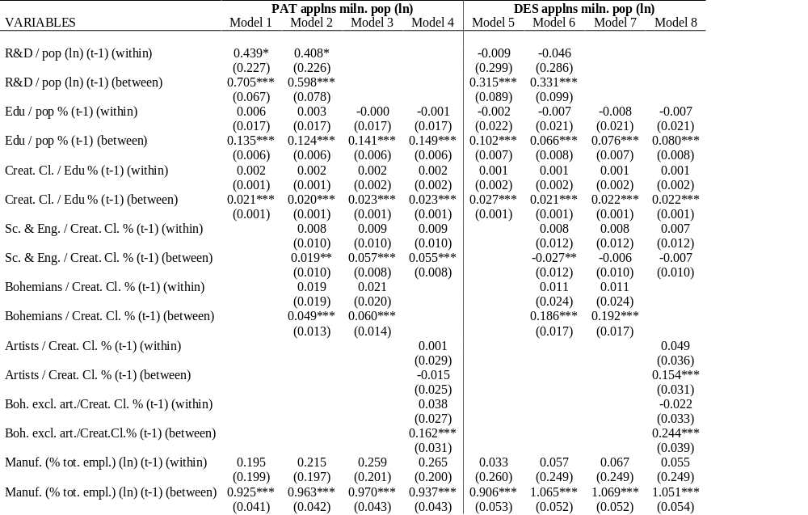

Slide 41
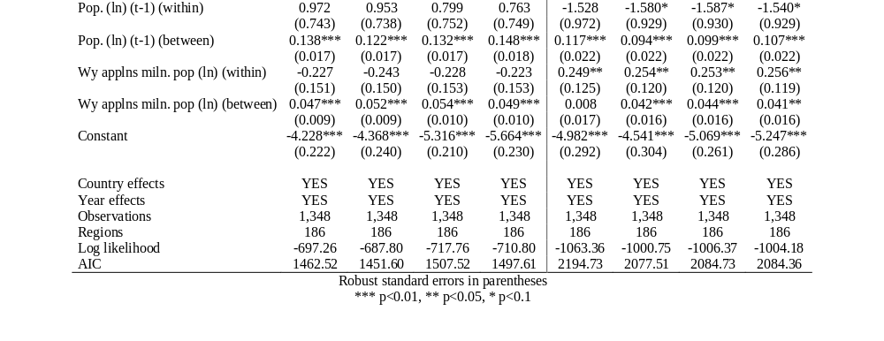

Slide 42
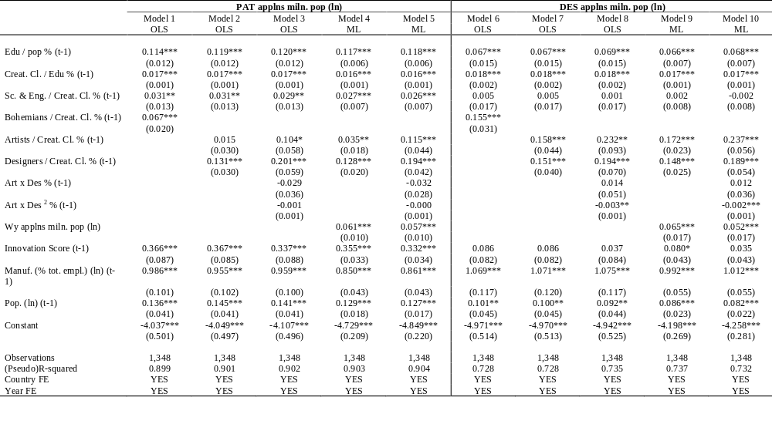

Slide 43
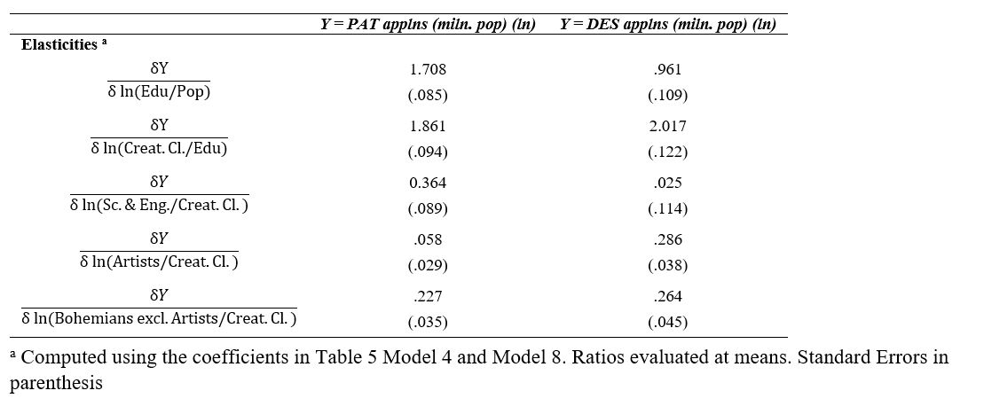
Results

