Slide 1
International Mobility@VIB
EWI
Marijke Lein – 12 October 2010

Slide 2
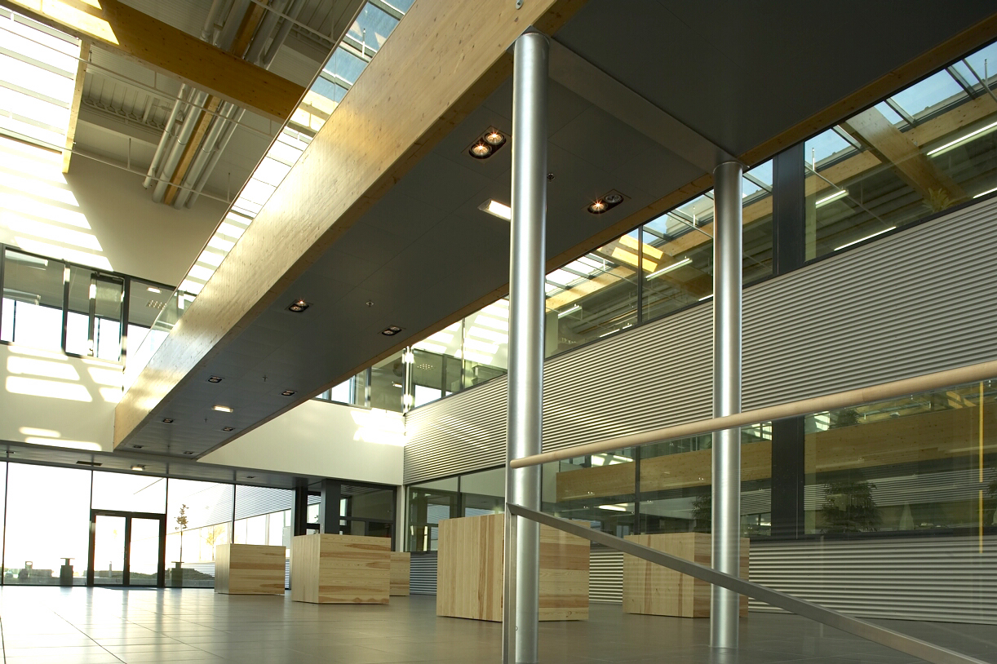
Mission
Conduct basic life sciences research
Transfer results to society
Inform the public

Slide 3
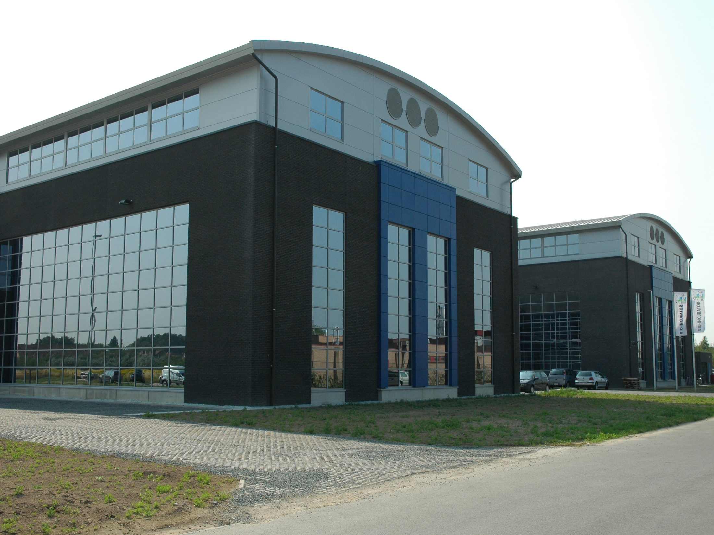
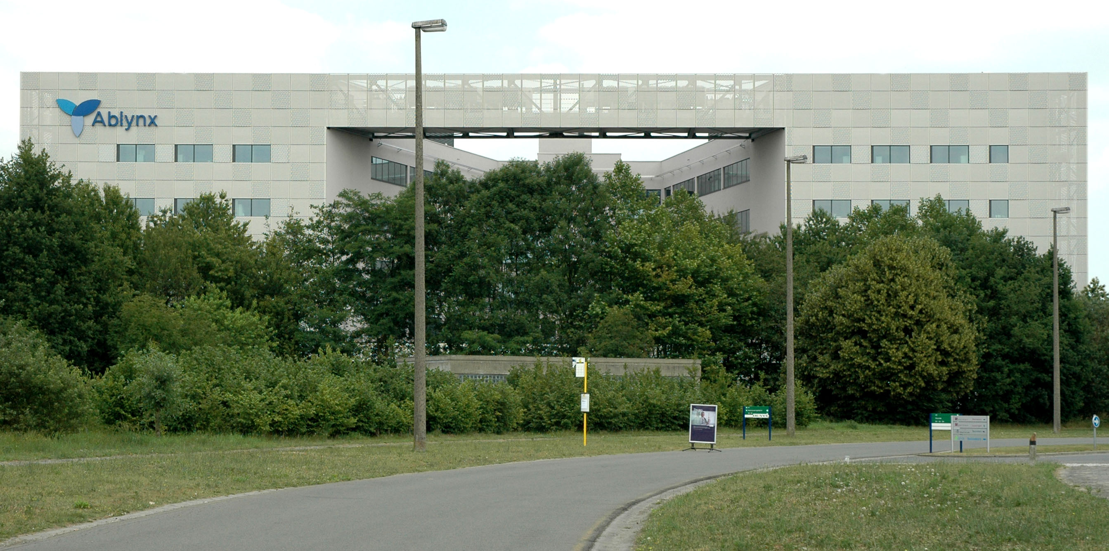

Techtransfer:
IP, patents, companies, jobs

Slide 4

Science
communication:
Playful and science-
based

Slide 5
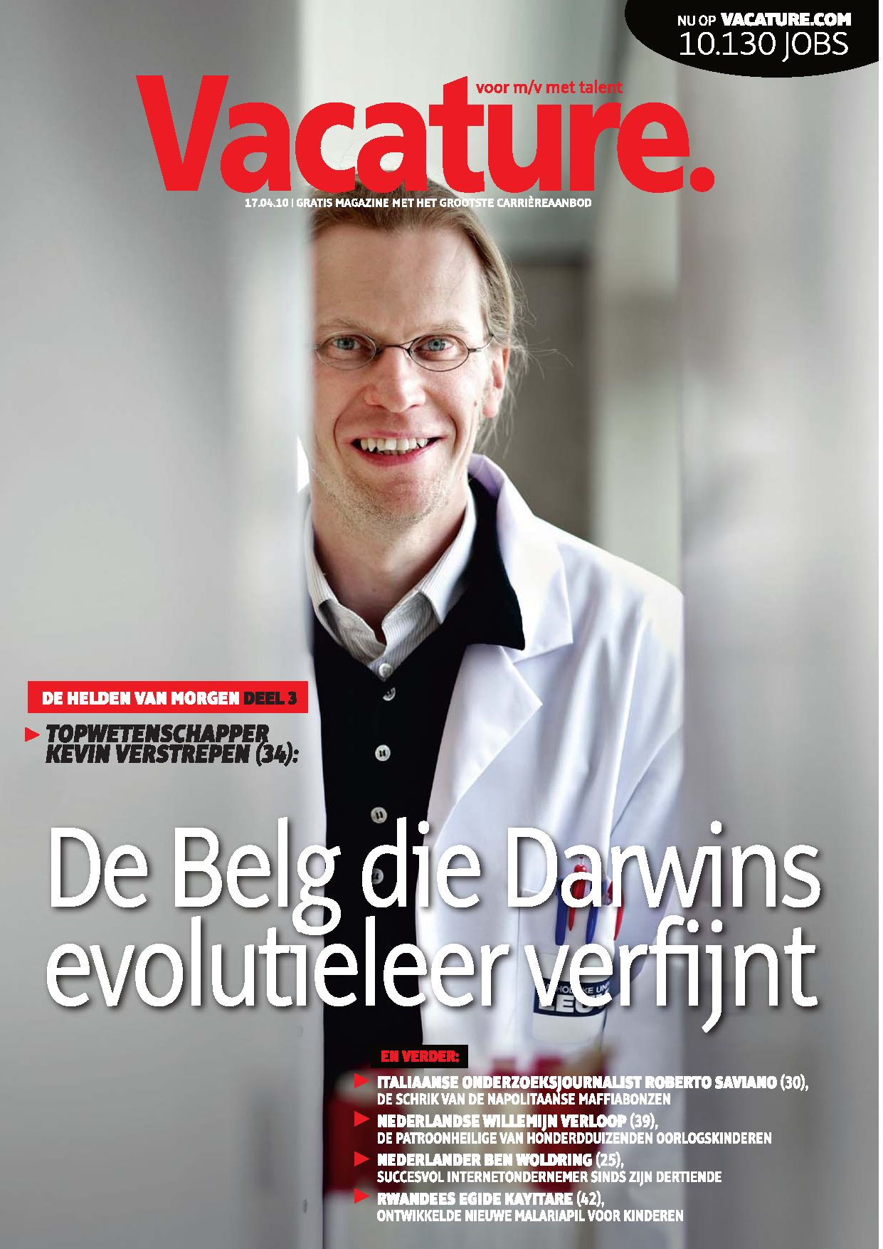
To secure public trust and support – Go out and tell your story!

Slide 6





72 research groups
4 universities
Antwerpen
Gent
Brussel
Leuven
Notes:
VIB is samenwerkingsverband tussen universiteiten.
Financiering
Technologie
Vorming
Ondersteuning

Slide 7
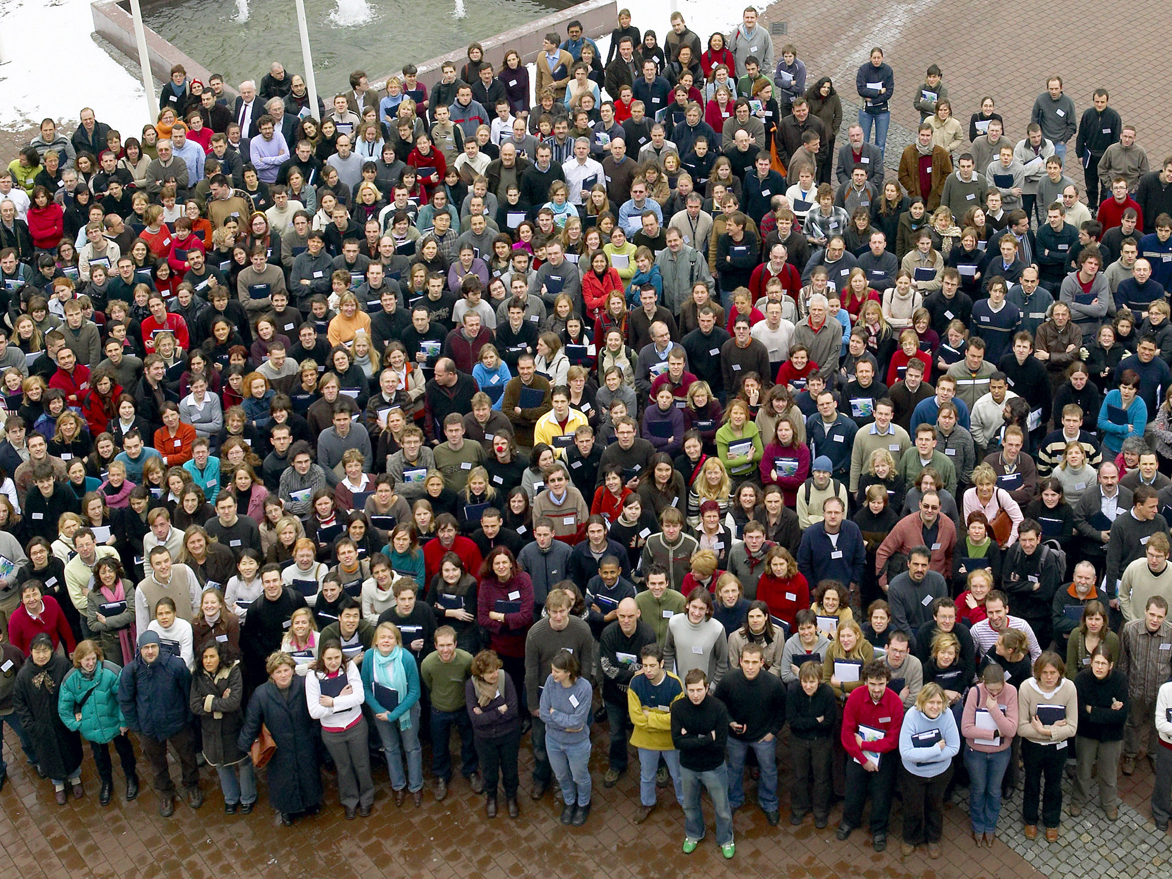
VIB = 1200 people
2009 = 223 new scientists
Notes:
In de loop van de jaren is het aantal mensen binnen VIB gestaag omhoog gegaan. Vorig jaar kwamen er 223 nieuwe medewerkers bij.

Slide 8
VIB: Themes

Slide 9
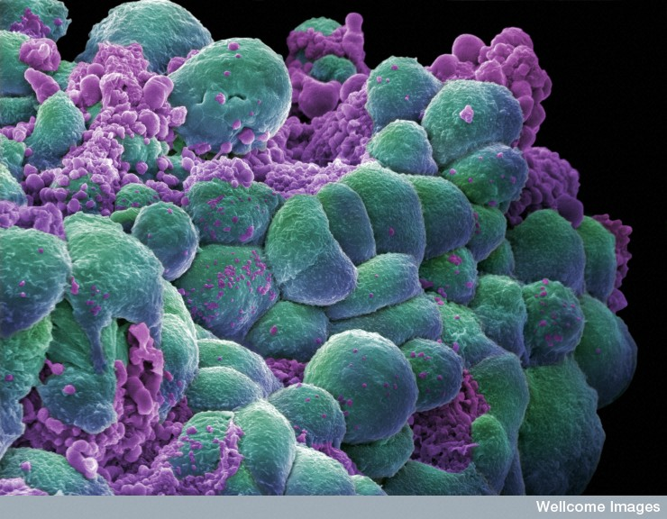
Cancer

Slide 10
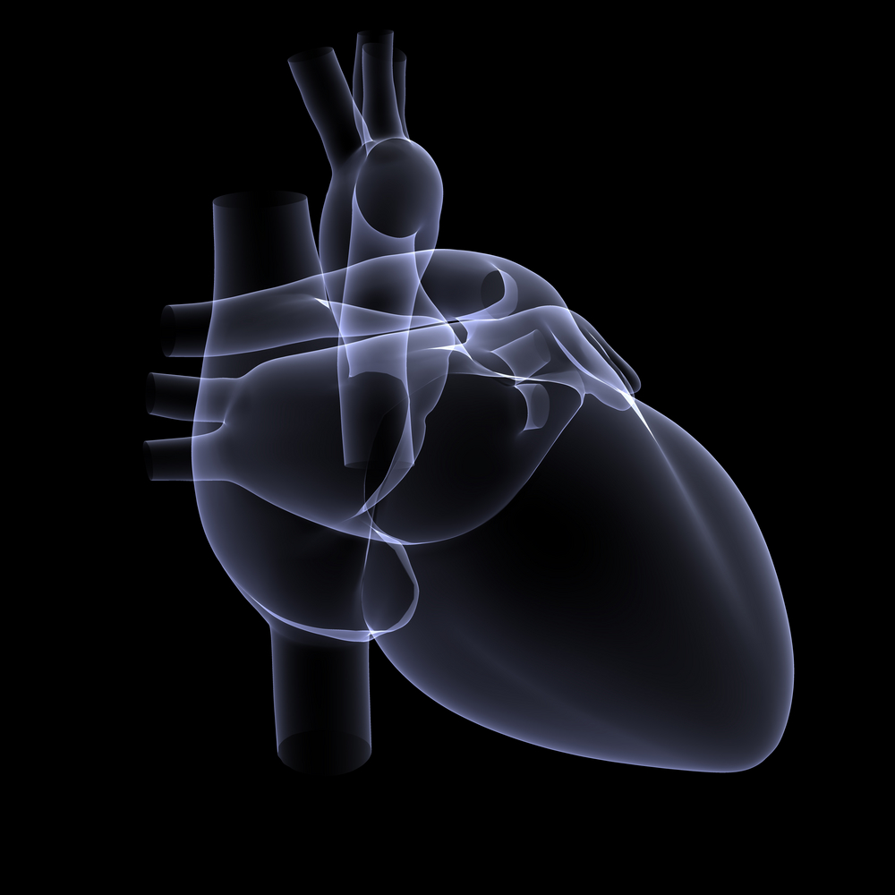
Cardio-vascular diseases

Slide 11
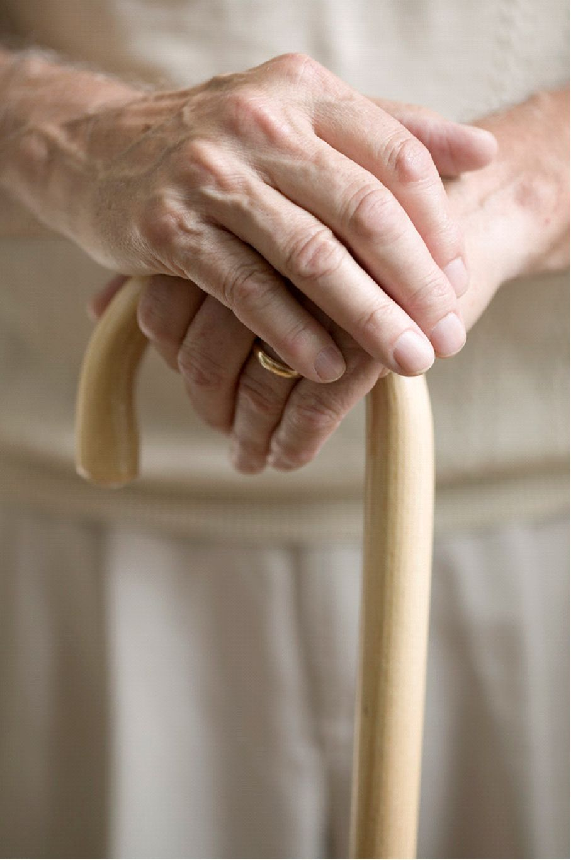
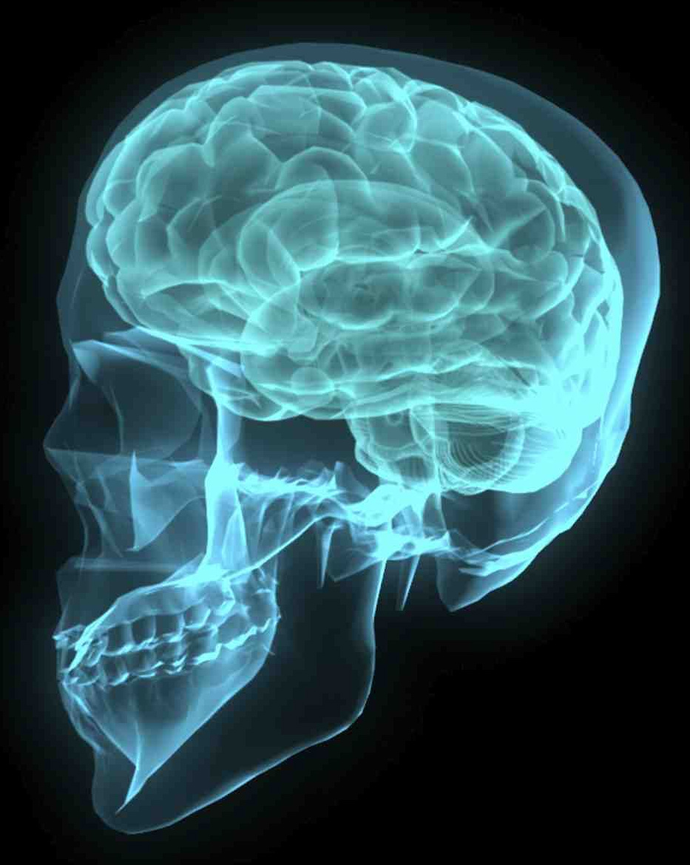
Neuroscience
Alzheimer, Parkinson
Dystonia, CMT

Slide 12
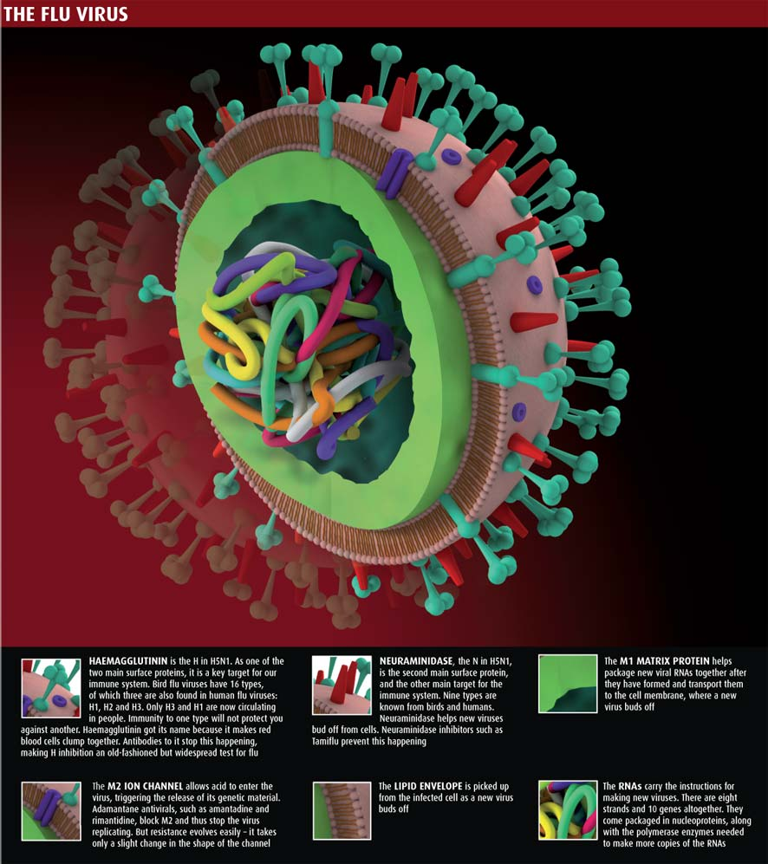
Infections and immunology

Slide 13
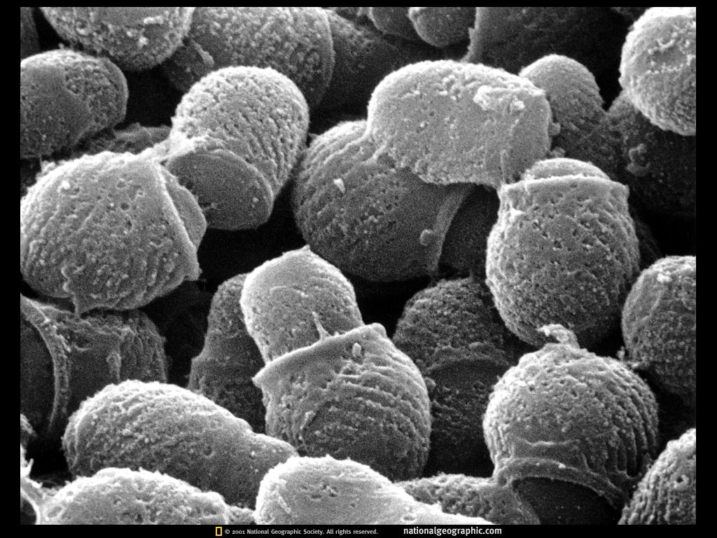
Microbiology

Slide 14
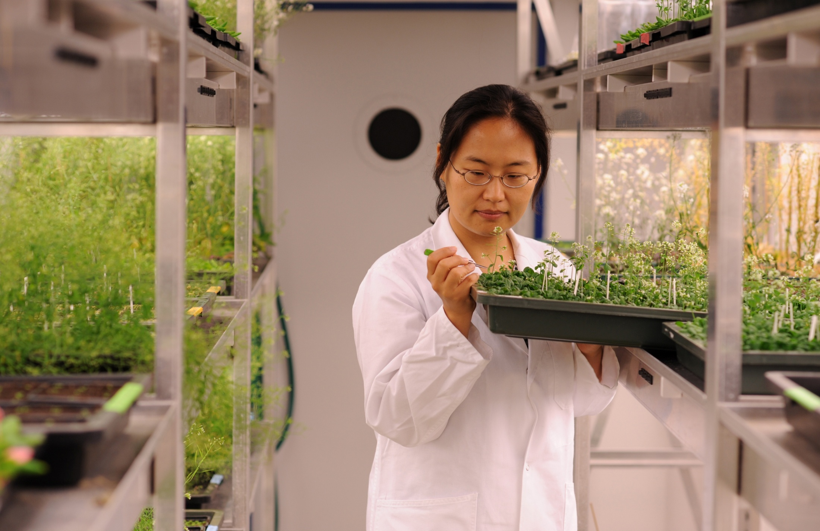
Plant biology
Notes:
We onderzoeken hoe planten groeien, bloeien, sterven… om die kennis te kunnen gebruiken bij het creëren van nieuwe gewassen

Slide 15
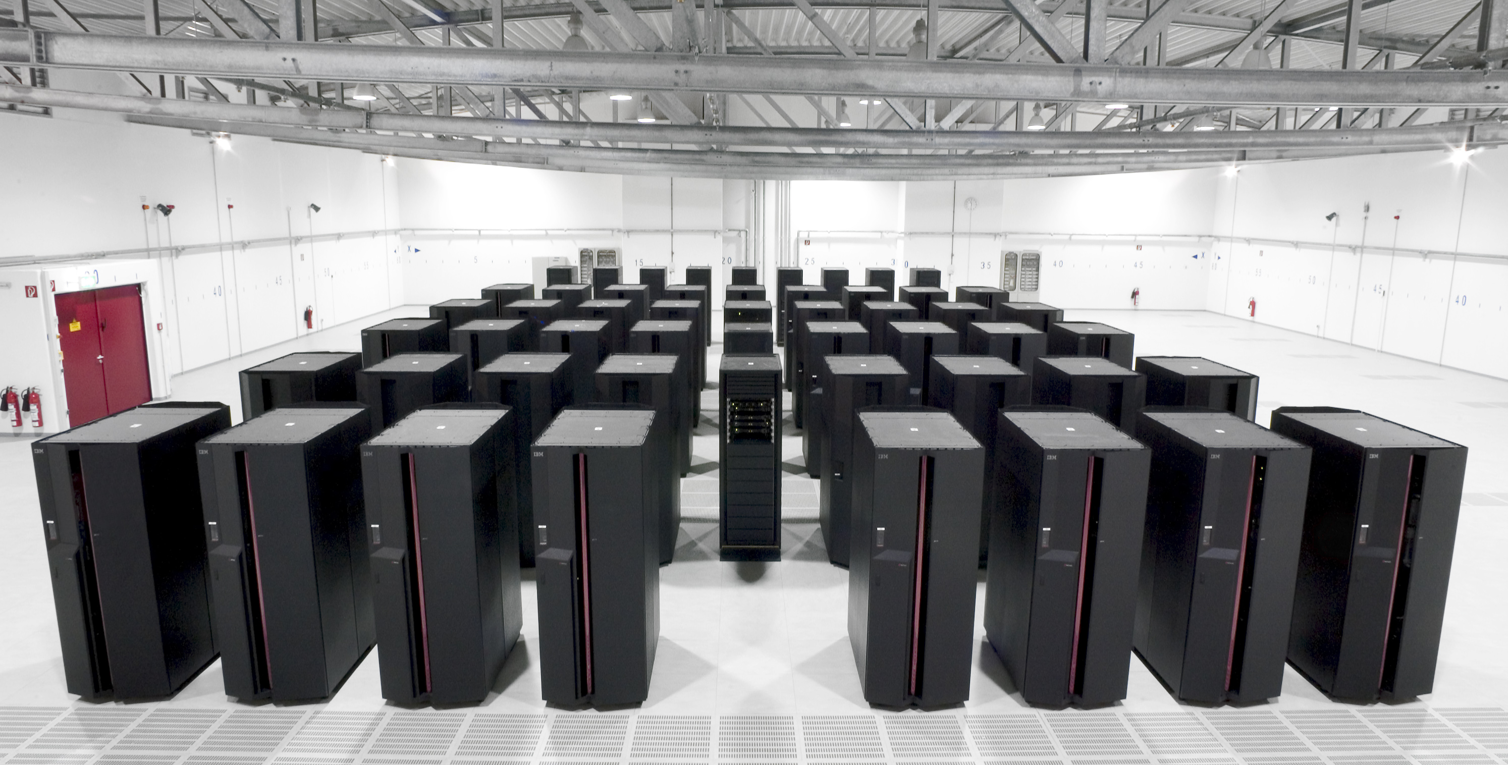
Bio-informatics

Slide 16
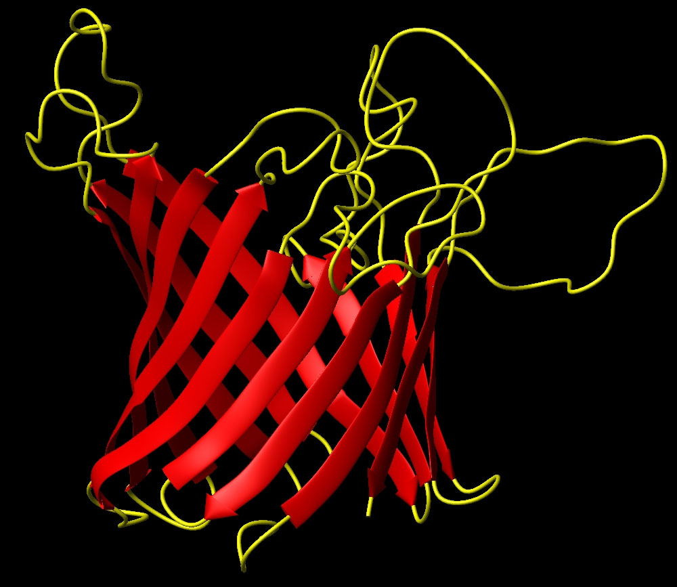
  Structural biology

Slide 17
VIB: an international and intercultural community

Slide 18
Why?
History of:
  Inbreeding
  Closed research community
Aim of VIB: wordplayer in life sciences
  - International recognition
  - Be known by the international research community

Slide 19
How to create international visibility?
Research output
  Publications
  Citations
Successful technology transfer
attractive to foreign top researchers

Slide 20
Some figures
 | 2001 - 2005 | 2006 - 2010
non-Belgian Ph.D. Students | X 11% | X 40%
non-Belgian postdocs | X 29% | X 50%
non-Belgian groupleaders | X 12% | X 17%
Currently : > 60 nationalities
33% of all scientific staff = non-Belgian

Slide 21
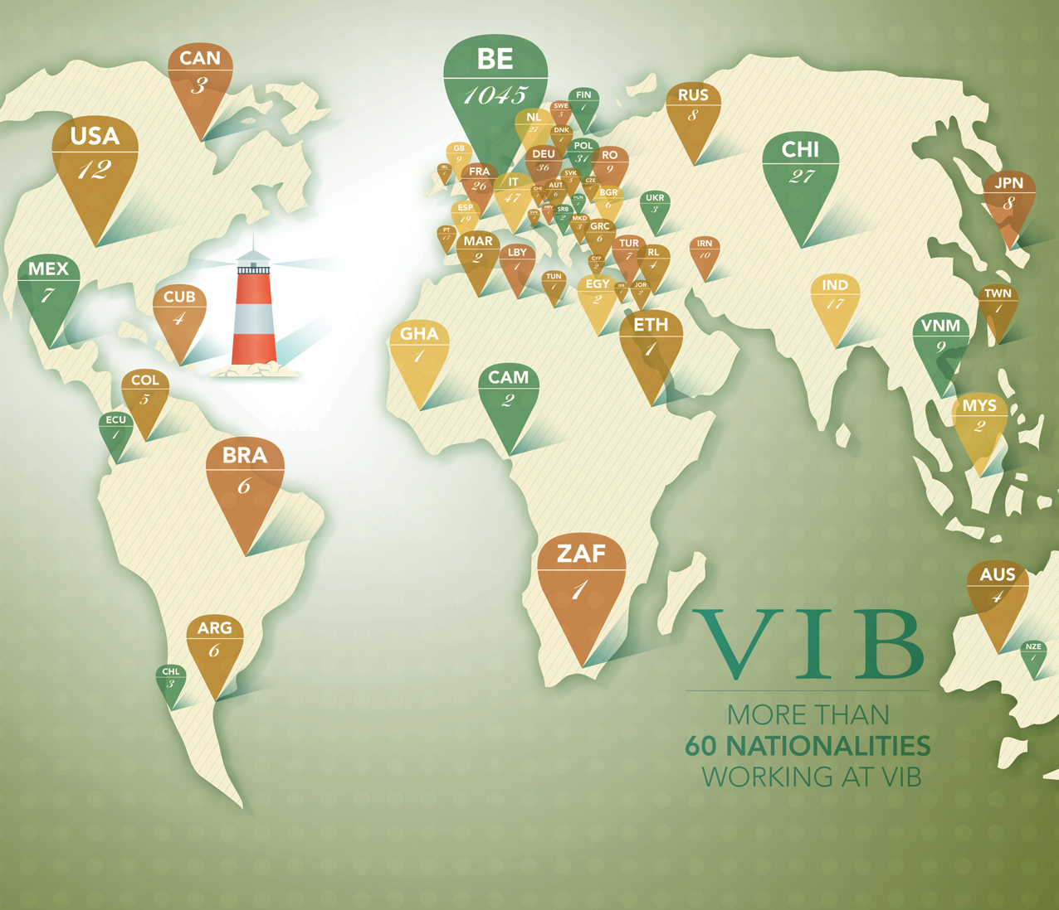
Notes:
Waarom kiezen voor internationalisatie?
Creativiteit
Excellentie

Slide 22
How?
International recruitment for
  Ph.D. Students
  Postdocs
  Groupleaders + experts
Reversed brain drain

Slide 23
Recruitment
All scientific positions: open recruitment
  VIB website
  Print Nature / Science / Cell / Neuron
  Jobsites (Nature, Science)
  Networking – congresses
  Own headhunting
  Open calls

Slide 24
Open calls
Junior group leaders
Independent group leaders / experts
Ph.D. Students
  International Ph.D. Program
  Important : what do you have to offer?

Slide 25
2009
4 new independent group leaders with own research funding and start up budget (2 million € / 5 years)
  50% international
7 new independent group leaders embedded in existing department
  100% international
Personnel structure in these new groups
  57% non-Belgian (50/88)

Slide 27
Push – Pull Factors
Push factors
  Reasons for leaving the current work and living place
    Circumstances typical for the home situation
    Personal/professional reasons
Pull factors
  Features of host institute/country which attract foreign researchers
  Miller – 2005
  Puustinen-Hopper - 2005

Slide 28
Push Factors
Typical for work and living place
  Poor research circumstances in own country
    Lack of financing
    Lack of career development
  Local labour market
    Lack of academic and permanent positions
    Low salaries, poor job security
  Mobility is prerequisite for career advancement in own country

Slide 29
Push Factors
Personal, professional reasons
  Mobility is felt as an important aspect of an academic career
  Enrichment of own CV – new professional challenges
  International experience is determining further career
  Personal enrichment (languages, culture) for researcher (and family)
  Partner
  Puustinen-Hopper - 2005

Slide 30
Pull Factors: Professional
Scientific reputation of country, universities, research groups – research culture
Favourable research conditions
  Funding, infrastructure, top researchers nearby
  Long term perspective
Professional network (joining a “known” lab)
Labour market in host country
  Long-term contracts
  Employment conditions (salary and benefits)

Slide 31
Pull Factors: Personal
Partner
Quality of life
Housing market
Availability of good schools
Child care
Social security
Jobs for spouse

Slide 32
Benefits for the organization
The world = recruitment area
Higher worldwide visibility of the institute
Network ↑
International collaborations ↑
International environment triggers foreigners to come

Slide 33
Benefits for the organization
Introduction of new concepts, ways of working, ideas, expertise
Creating open-minded and diverse culture
Broaden the horizon of the local researchers and technicians
Trigger for Belgians to pursue scientific career abroad

Slide 34
Challenges
Long decision process for the foreign researcher (GL)
  Plenty of possibilities (wanted!)
  A lot is at stake
Expensive hires
  Recruitment process (travel, visits)
  Salary (expat status)
  Laboratory package: substantial investment
  Family issues

Slide 35
Limits
Question: optimal balance between locals & non-locals?
Watch out for “islands” of foreign research groups
  Foreign GL: bring own country-men!
  Suggestion: max. 50% of co-workers of same nationality

Slide 36
Migration Issues
Entry process non-EU members
  Unpredictable in time
  Non-enthousiastic cooperation in embassy/consulate
  Regulations not always known by all parties involved: embassies, local authorities
  Different decision makers for work permit vs visa
    Flemish vs Federal
  Family reunion
    Very difficult, heavy demands on paperwork

Slide 37
Migration Issues
Entry process EU members
  No work permit and visa required: easy entry
  Registration process in Belgian commune not easy and slow

Slide 38
Support HR
Daily assistance and support during
  Pre-entry and post arrival period
    To do’s for work permit/visa
    Move
    Support with registration process
    Bank account, social security

Slide 39
Support HR
Assistance for families
  House-hunting
  Info schooling
  Daily life in Belgium
  Relocation company
Spouse?
  Assistance in job hunting: consultant
  Position at VIB if possible
⇨ Higly appreciated

Slide 40
Conclusion
Internationalization?
YES
But......
Thank you!

