Slide 1
EURAXESS – Researchers in Motion
We care about mobile researchers!

Slide 2


What is EURAXESS
Why should you get involved
and why is EURAXESS for researchers?
Added value of the EURAXESS initiatives
How can we help researchers?
Whom to contact?

Slide 3

What is EURAXESS?
EURAXESS is a unique initiative, launched by the European Commission to promote research careers and facilitate the mobility of researchers across Europe.
The initiative was created to stimulate, protect and nurture the European Research and Innovation environment, providing the researcher community with access to improved careers and better social protection.

Slide 4



What is EURAXESS?
EURAXESS is a one-stop shop for the development
of research careers in Europe with the support of a network
of people to assist researchers and research organisations

Slide 5


Why should you get involved and
why is EURAXESS for researchers?
  EURAXESS enhances researcher careers in Europe by providing them with:
  Information on jobs and funding opportunities across Europe
  Integrated mobility services that will make their move
  to another country as smooth as possible
  Information on their rights and obligations and those of their
  employers and funders
  Personalised assistance by people dedicated to help them
  (But it also provides services to research organisations….)
  All these services are for free!

Slide 6




Why should you get involved and
why is EURAXESS for researchers?
EURAXESS develops its activities under the following
4 key initiatives:
Helps to find jobs, funding opportunities, grants,
etc.
Offers a network of over 500 people in
36 countries to assist researchers & their families
Looks after researcher rights
Connects European researchers worldwide

Slide 7


Why should you get involved and
why is EURAXESS for researchers?

Slide 8
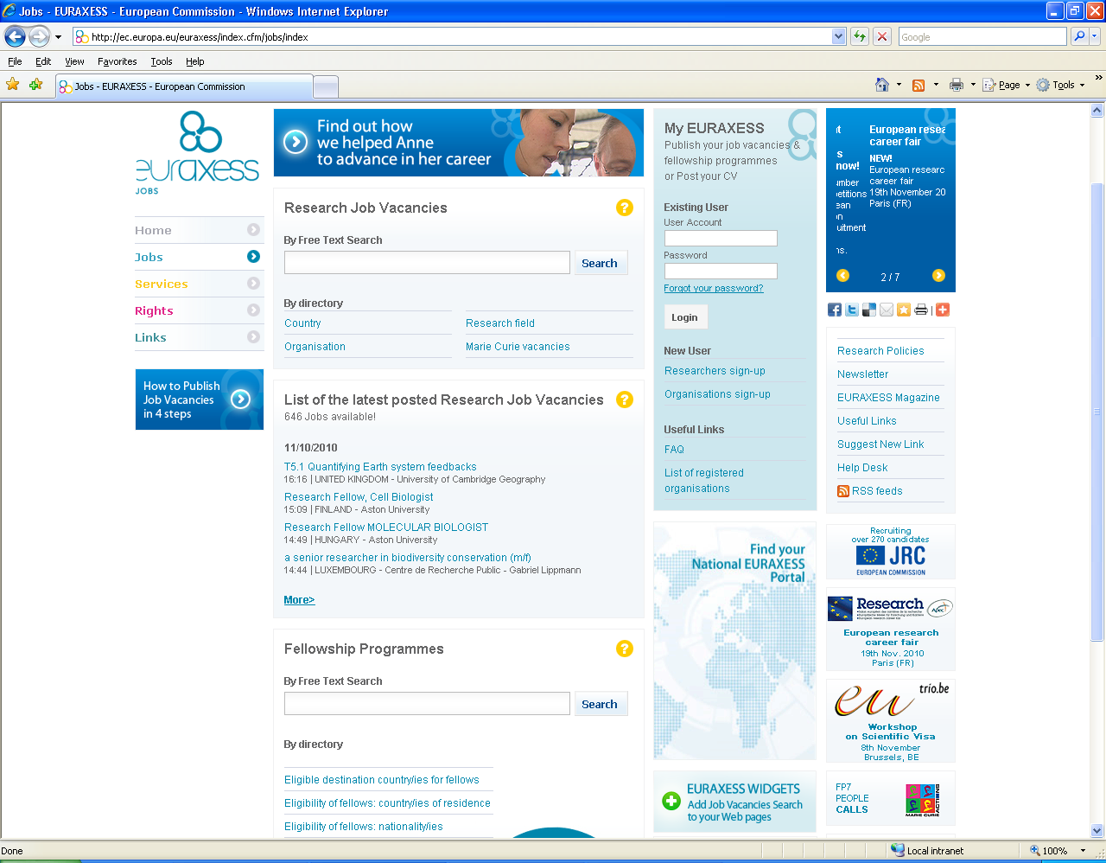

Slide 9
Why should you get involved and
why is EURAXESS for researchers?
  EURAXESS Jobs
  Our database of job opportunities is growing every day and we are
  developing to become THE reference in research recruitment
  Job and funding opportunities cover a vast array of research fields
  ranging from Neurosciences to IT
  Via our website researchers can post their CV for the attention of
  potential employers across Europe and beyond
  EURAXESS Jobs is completely free of charge!
  Over 16,000 researchers have registered on-line

Slide 10
Why should you get involved and
why is EURAXESS for researchers?
  Over 4 600 research organisations, companies, universities
  and SMEs are registered on EURAXESS. These potential employers
  browse the CVs to find the best research talent to fill their positions
  Belgian registered organisations: 225
  Belgian job vacancies published in 2009: 320
  To date, 38 job vacancies with community language Flemish (since May 2010: 94)
  A total of almost 5 000 research job vacancies from 30 different
  countries were published in 2009

Slide 11
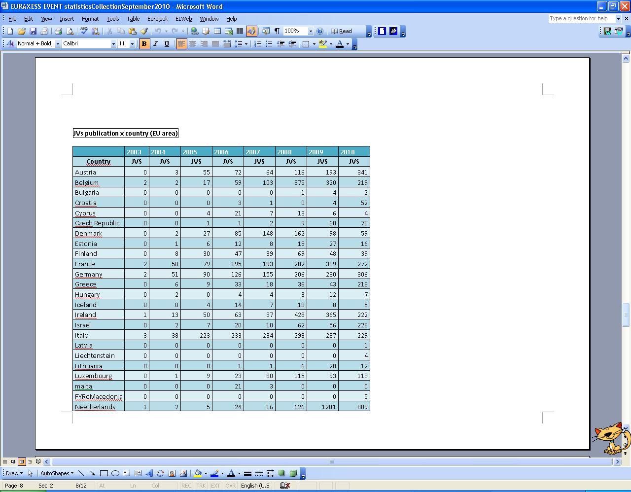
Belgian job vacancies published on-line since 2003

Slide 12
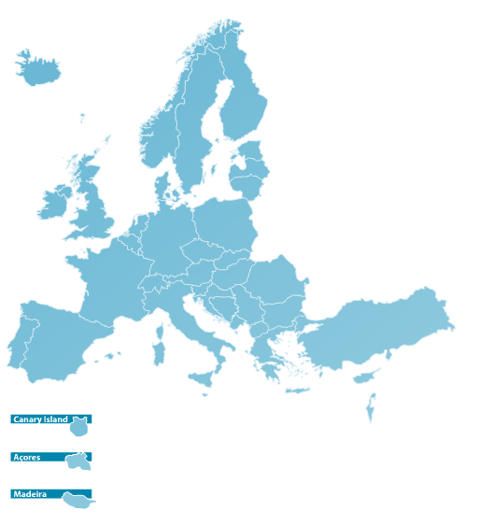
The national EURAXESS portals
  To date 30 national EURAXESS portals complement the European one.
  In Belgium EURAXESS Belgium = EURAXESS Flanders & EURAXESS French-speaking Community

Slide 13
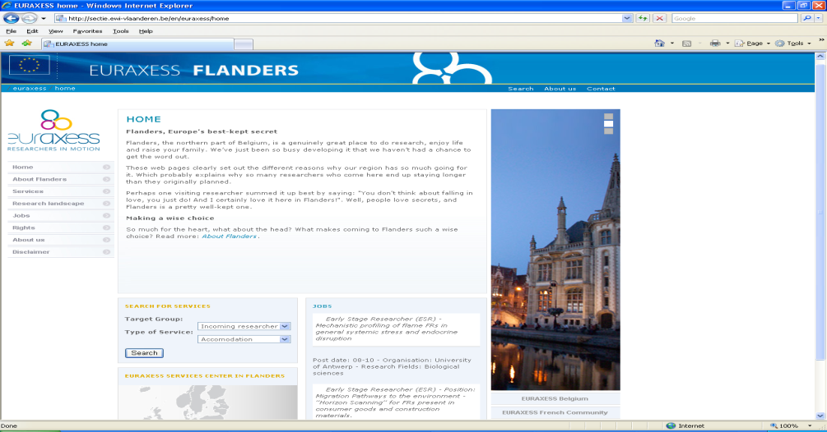
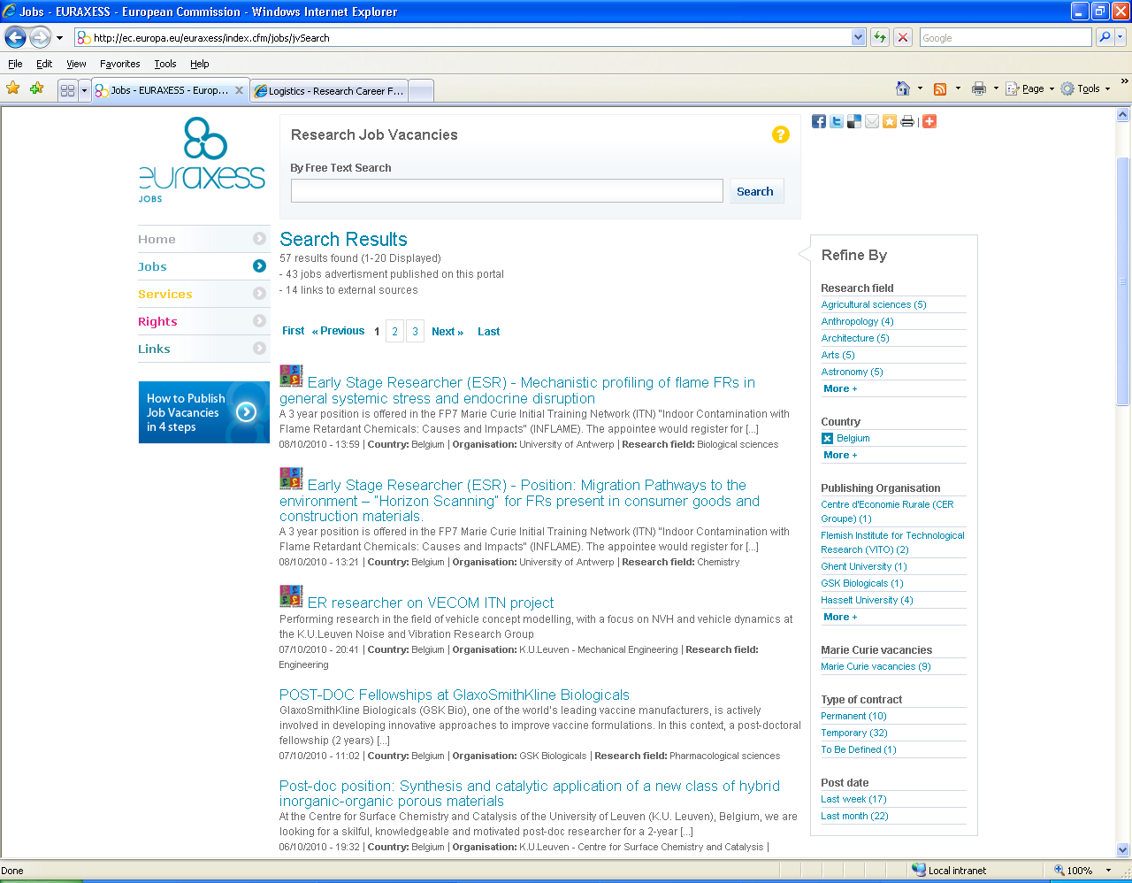
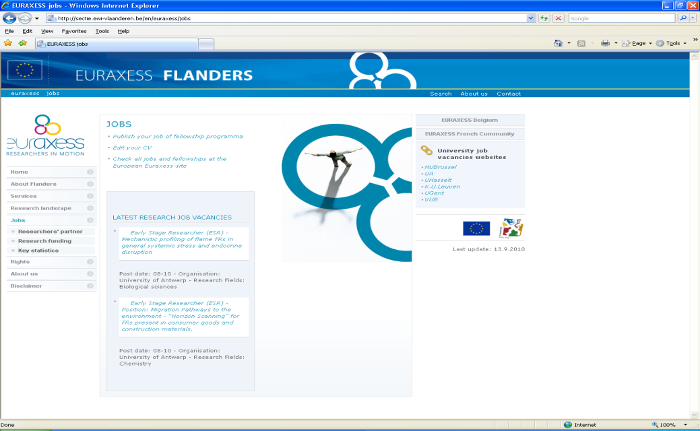
Exchanging job info: from EURAXESS Jobs to EURAXESS Belgium/Flemish Community & more
Visibility!

Slide 14


More for you…

Slide 15

Why should you get involved and
why is EURAXESS for researchers?
  EURAXESS Services
  Initiative exclusively devoted to help you and your family by providing
  practical information about administrative and legal issues that make
  your life easier as a researcher and help you move from one country
  to another.
  A network of 500 people distributed in 200 offices across
  Europe provides you with personalised assistance and will
  welcome you in your new host country.

Slide 16

2
  EURAXESS Services
  Researchers can get advice on topics such as:
Why should you get involved and
why is EURAXESS for you?
Recognition of academic qualifications
Visa formalities
Accommodation
Guidance on the implementation of the Charter&Code
Language courses
Taxation
Information about country/city
Health/Medical
care
Intellectual property rights
Family
Social security
Childcare
School
Work permits

Slide 17
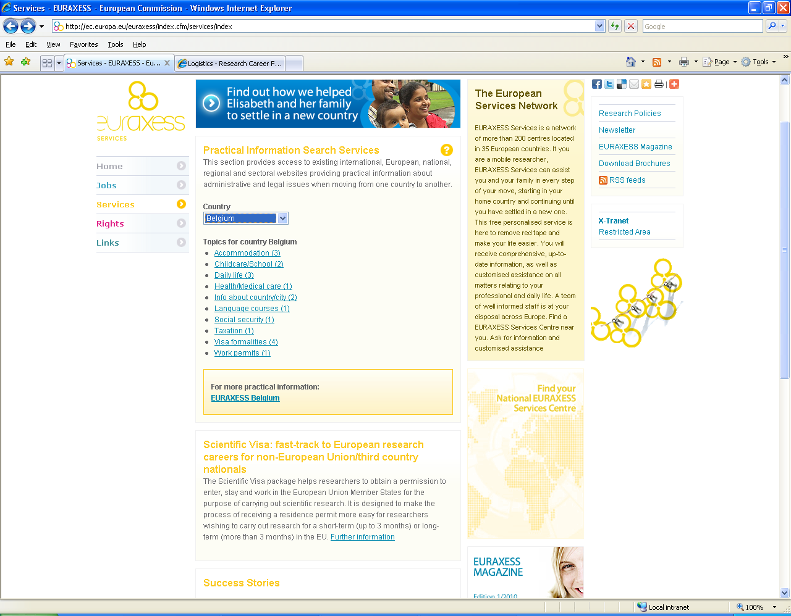
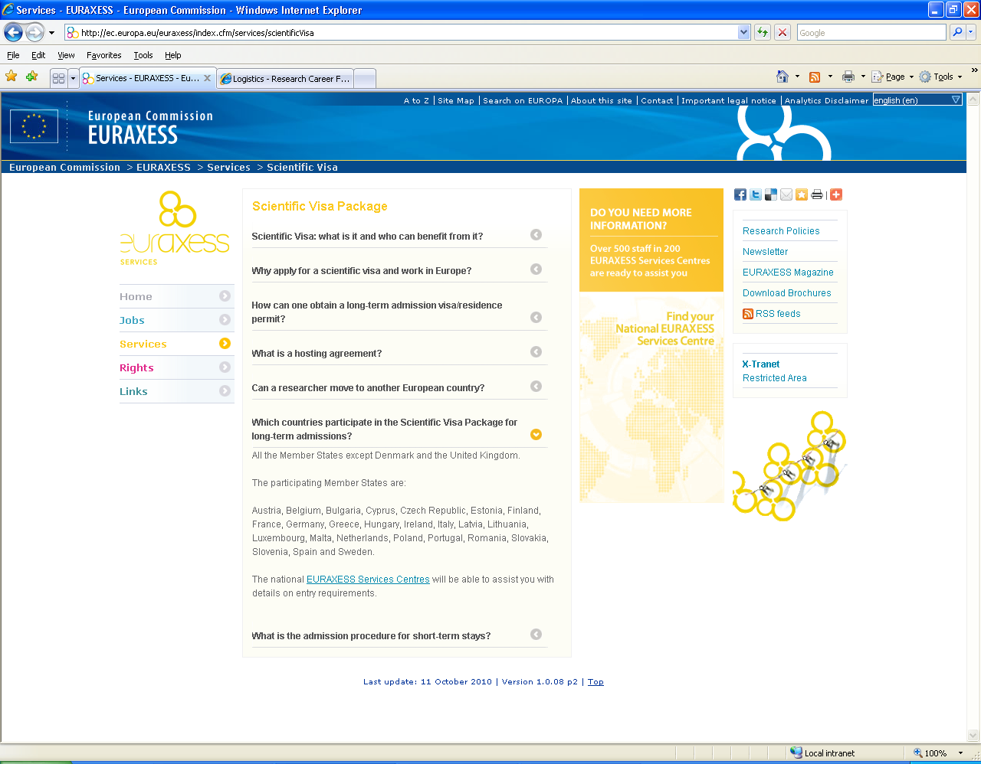
Visa formalities (Belgium)

Slide 18

And more…

Slide 19

Why should you get involved and
why is EURAXESS for researchers?
  EURAXESS Rights
  The European Union puts a high priority on researcher rights and
  obligations
  It focuses on good working conditions and adequate career
  development opportunities
  It promotes fairness in relation to social security, pensions, and other
  rights for researchers

Slide 20
2
Why should you get involved and
why is EURAXESS for researchers?
2
  Key document: European Charter for Researchers
  and Code of Conduct for their Recruitment
  Today more than 220 organisations representing some 1 000
  institutions from 30 countries in Europe and beyond have endorsed the principles of Charter and Code

Slide 21

Why should you get involved and
why is EURAXESS for researchers?
  EURAXESS Rights Initiative ‘Human Resources Excellence in Research’
  The ‘Human Resources Excellence in Research’ logo is awarded to institutions that have made significant progress in implementing the Charter and Code
  To date, 23 institutions from across Europe have gained this recognition
  Soon, those publishing jobs will have the HR logo close to their job vacancy

Slide 22
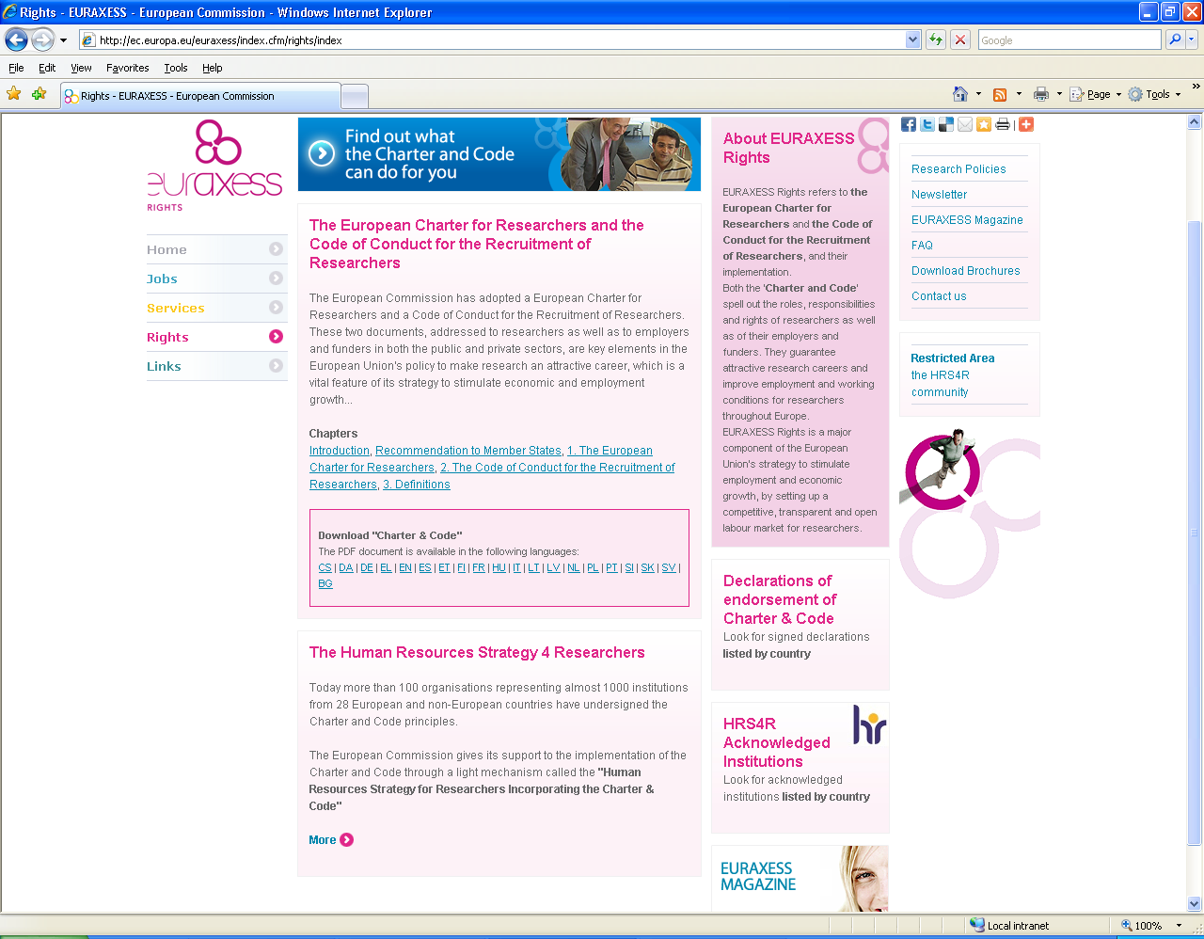
Why should you get involved and
why is EURAXESS for researchers?

Slide 23

How can we help researchers & you?
  Visit the European website at
  http://ec.europa.eu/euraxess
  or EURAXESS Flanders
  www.euraxess.be/flanders
  Subscribe to the EURAXESS newsletter
  Explore the Facebook pages for Estonia,
  Serbia, Czech Republic, Romania and
  Lithuania where you can interact with other
  EURAXESS fans!!

Slide 24

Merci!
http://ec.europa.eu/euraxess
or
rtd-rmp@ec.europa.eu

